Slide 1
EXL service
Basic R modules

Slide 2
Contents
Section | Chapter
Building blocks in R | Introduction to R
 | Vectors
 | Lists
 | Arrays and Matrices
 | Data Frames
 | Factors
 | Import / Export
Control structures in R | Control flow
 | Loops
 | Functions
 | apply
 | sapply
 | lapply
Data manipulation | Utilities
 | Data Cleaning
 | dplyr
Visualization | ggplot2, plot

Slide 3
Chapter 1: Introduction To R
Introduction
R vs. SAS
Official Documentation
Getting help
Help from the Internet
CRAN
Getting Started
Modes of running R
Arithmetic operations
Variables/Objects in R
Common data structures in R
R Workspace
Notes:
2

Slide 4
Introduction
Basic History
R, also called the Language for Statistical Computing
Developed by Ross Ihaka and Robert Gentleman at University of Auckland
It is considered an open source implementation of the S language, which was developed by John Chambers in the Bell Laboratories in the 1980s
Initially developed for data analysis, now provides a wide variety of statistical techniques and visualization capabilities which are highly extensible
The R environment
R is an integrated suite of software facilities for data manipulation, calculation and graphical display
The term “environment” is intended to characterize it as a fully planned and coherent system, rather than an incremental accretion of very specific and inflexible tools, as is frequently the case with other data analysis software
R is a vehicle for newly developing methods of interactive data analysis. It has developed rapidly, and has been extended by a large collection of packages. However, most programs written in R are essentially ephemeral, written for a single piece of data analysis
Notes:
3

Slide 5
R vs. SAS
 | SAS | R
Memory Processing | Data stored on disk Execution is slower Can handle bigger data with relative ease | In memory (RAM) Makes execution faster Runs out of memory (high RAM requirement), advancements in parallel processing helps overcome this issue
Processes/ Algorithm coverage | More accurate implementation Slower development and release of algorithms | Fast paced development of new algorithms Open source “package” development contributes to this
Syntax | High level language Easier to learn | R is close to C++ in syntax Packages have their own syntaxes Case sensitive
Pricing Structure | Very costly, out of reach of individual developers | Open source, free to download
Personalization | Difficult to impossible | Codes can be easily modified as R is open source
Support | Supported by SAS Inc. | Supported by open source community, has a dedicated mailing list
Documentation | Accurate and up to date white papers released by SAS for all the procedures | Available, but quality not high as SAS

Slide 6
Official Documentation for R
What documentation exists for R?
Online documentation for most of the functions and variables in R exists, and can be printed on-screen by typing help(name) (or ?name) at the R prompt
The R distribution also comes with the following manuals, can be found at :
https://www.r-project.org/foundation/
An Introduction to R (R-intro) includes information on data types, programming elements, statistical modeling and graphics..
Writing R Extensions (R-exts) currently describes the process of creating R add-on packages, writing R documentation, R’s system and foreign language interfaces, and the R API.
R Data Import/Export (R-data) guide to importing and exporting data to and from R.
The R Language Definition (R-lang) explains evaluation, parsing, object oriented programming, computing on the language, and so forth.

Slide 7
Getting help
The help function
Special characters and some reserved words must be quoted when used with the help() function
> help(seq)
> ?seq
> ?“<”
> ?“for”
The Example function
Each of the help entries comes with examples. One really nice feature of R is that the example() function will actually run those examples for you
> example(seq)
seq> seq(0, 1, length.out=11)
[1] 0.0 0.1 0.2 0.3 0.4 0.5 0.6 0.7 0.8 0.9 1.0
seq> seq(stats::rnorm(20))
[1] 1 2 3 4 5 6 7 8 9 10 11 12 13 14 15 16 17 18 19 20
seq> seq(1, 9, by = 2) # match
[1] 1 3 5 7 9
seq> seq(1, 9, by = pi)# stay below
[1] 1.000000 4.141593 7.283185
seq> seq(1, 6, by = 3)
[1] 1 4
seq> seq(1.575, 5.125, by=0.05)
[1] 1.575 1.625 1.675 1.725 1.775 1.825 1.875 1.925 1.975 2.025 2.075 2.125
[13] 2.175
..
> #Try this to get glimpses of R graphics
> example(persp)

Slide 8
Help from the internet
The R Project’s own manuals are available from the R home page, http://www.r-project.org/. Click Manuals.
Rdocumentation.org
CRAN
Search on github for similar implementations
RSeek search engine: http://www.rseek.org/.
Stackoverflow is your friend
You can post your R questions to r -help, the R list server. You can obtain information about this and other R list servers at http://www.rproject.org/mail.html.
Google Tip
To search for R scripts (files having a .R suffix) pertaining to permutations, enter this:
filetype: R permutations –rebol
The -rebol excludes pages with the REBOL programs as it uses the same suffix.

Slide 9
CRAN – The Comprehensive R Archive Network
It is a collection of sites which carry identical material, consisting of the R distribution(s), the contributed extensions, documentation for R, and binaries
CRAN officially supports the open source version of R
It develops and curates packages, produces newer versions of R and create documentation
There are multiple mailing lists from CRAN
Mailing List | Purpose
R-announce | A moderated list for major announcements about the development of R and the availability of new code
R-packages | A moderated list for announcements on the availability of new or enhanced contributed packages
R-help | The ‘main’ R mailing list, for discussion about problems and solutions using R, announcements (not covered by ‘R-announce’ and ‘R-packages’) about the development of R and the availability of new code.
R-devel | This list is for questions and discussion about code development in R
R-package-devel | A list which provides a forum for learning about the R package development process

Slide 10
Getting Started
After installing R, or logging into system having R, open command line or terminal and simply type R
This will launch R interpreter and you will get a prompt “>”, where you can start typing your program as follows −
Here, the first statement defines a string variable myString, where we assign the string "Hello, World!"
The print() statement is used to print the value stored in variable myString.
To exit R, type “q()”
$ R
> myString <- "Hello World!"
> print ( myString)
[1] "Hello World!"
> q()

Slide 11
Batch mode vs. Interactive mode
R Script File:
Usually, programs are written in script files and then executed at command prompt with the help of R interpreter called Rscript. So let's start with writing following code in a text file called test.R
Save the above code in a file test.R and execute it at Linux command prompt as given below. Even if you are using Windows or other system, syntax will remain same.
When we run the above program, it produces the following result:
> # My first program in R Programming
> myString <- "Hello, World!"
>
> print ( myString)
$ Rscript test.R
[1] "Hello, World!"

Slide 12
Arithmetic Operations
R works like a calculator, you type an expression and get the answer:
Standard arithmetic operators are +, -, *, and /, to add, subtract, multiply and divide; and ^ for exponentiation (so 2^3=8). These operators have the standard precedence, with exponentiation highest and addition/subtraction lowest, but you can always control the order of evaluation with parentheses. You can use mathematical functions, such as sqrt, exp and log. For example
R also understands relational operators <=, <, ==, >, >= and != for less than or equal, less than, equal, greater than, greater than or equal, and not equal, respectively. These can be used to create logical expressions that take values TRUE and FALSE (or T and F for short). Logical expressions may be combined with the logical operators | for OR and & for AND, as shown further below.
> 1+2
[1] 3
> log(0.3/(1-0.3))
[1] -0.8472979
> 1==2
[1] FALSE

Slide 13
Variables / Objects assignments in R
Variables are reserved memory locations to store values, which implies that the creation of a variable reserves some space in memory
Data analysis may require to store information of various data types like character, wide character, integer, floating point, double floating point, Boolean etc.
Based on the data type of a variable, the operating system allocates memory and decides what can be stored in the reserved memory.
In contrast to other programming languages like C and java in R, variables are not declared as some data type
Variables are assigned with R-Objects and the data type of the R-object becomes the data type of the variable.
There are many types of R-objects. The frequently used ones are −
Vectors
Lists
Matrices
Arrays
Factors
Data Frames

Slide 14
Common data structures in R
Vectors
The elements of a vector must all have the same mode, or data type
For example, a vector can consist of three character strings (of mode character) or three integer elements (of mode integer), but not a vector with one integer element and two character string elements
Scalars
Scalars, or individual numbers, do not really exist in R. What appear to be individual numbers are actually one-element vectors
Consider the following:
> x <- c(1,3)
> x
[1] 1 3
> str_x <- c(“a”,“ab”,“abc”)
> x <- 8
> x
[1] 8

Slide 15
Common data structures in R (contd.)
Factors
A Factor is an R objects which is created using a vector. It stores the vector along with the distinct values of the elements in the vector as labels
Labels are always stored as characters, irrespective of whether the values are numeric or character or Boolean in the input vector
Factors are especially useful in statistical modeling
Factors are created using the factor() function
The nlevels function returns the number of levels in the factor variable
> # Create a vector.
> apple_colors <- c('green','green','yellow','red','red','red','green')
> # Create a factor object.
> factor_apple <- factor(apple_colors)
> # Print the factor.
> print(factor_apple)
[1] green green yellow red red red yellow green Levels: green red yellow
> # applying the nlevels function we can know the number of distinct values
> print(nlevels(factor_apple))
[1] 3

Slide 16
Common data structures in R (contd.)
Character Strings
Character strings are single-element vectors of mode character
> x <- c(5,12,13)
> x
[1] 5 12 13
> length(x)
[1] 3
> mode(x)
[1] "numeric"
> y <- "abc"
> y
[1] "abc"
> length(y)
[1] 1
> mode(y)
[1] "character"
> z <- c("abc","29 88")
> length(z)
[1] 2
> mode(z)
[1] "character"

Slide 17
Common data structures in R (contd.)
Matrices
A matrix is a rectangular array of numbers
Technically, a matrix is a vector, but with two additional attributes – number of rows and number of columns. Here is some sample matrix code:
Lists
Like a vector, an R list is a container of values, but its contents can be of different data types
List elements are accessed using two-part names, which are indicated with the dollar sign ‘$’ in R. Here’s a quick example
> m <- rbind(c(1,4),c(2,2))
> M
[,1] [,2]
[1,] 1 4
[2,] 2 2
> x <- list(u=2, v="abc")
> x
$u
[1] 2
$v
[1] "abc"
> x$u
[1] 2

Slide 18
Common data structures in R (contd.)
Arrays
While matrices are confined to two dimensions, arrays can be of any number of dimensions
The array function takes a dim attribute which creates the required number of dimensions
In the below example, we create an array with two elements, each of which are 3x3 matrices
# Create an array.
> a <- array(c('green','yellow'),dim = c(3,3,2))
> print(a)
, , 1
[,1] [,2] [,3]
[1,] "green" "yellow" "green"
[2,] "yellow" "green" "yellow"
[3,] "green" "yellow" "green"
, , 2
[,1] [,2] [,3]
[1,] "yellow" "green" "yellow"
[2,] "green" "yellow" "green"
[3,] "yellow" "green" "yellow"

Slide 19
Common data structures in R (contd.)
Data Frames
A typical dataset contains data of different modes, which causes matrices to not be feasible for dataset operations
Hence, we use a data frame. A data frame in R is a list, with each component of the list being a vector corresponding to a column in our “matrix” of data. You can create data frames as shown below:
Typically though, data frames are created by reading in a data set from a file or database
> d <- data.frame(list(kids=c("Jack","Jill"),ages=c(12,10)))
> d
kids ages
1 Jack 12
2 Jill 10
> d$ages
[1] 12 10

Slide 20
R Environment
The workspace is the current R working environment and includes any user-defined objects (vectors, matrices, data frames, lists, functions).
At the end of an R session, the user can save an image of the current workspace that is automatically reloaded the next time R is started.
Commands are entered interactively at the R user prompt. Up and down arrow keys scroll through your command history. User may want to keep different projects in different physical directories.
Next slide has are some standard commands for managing the workspace.
FOR WINDOWS USERS: R gets confused if user specifies a path in code like c:\mydocuments\myfile.txt This is because R sees "\" as an escape character. Instead, use c:\\my documents\\myfile.txt
OR c:/mydocuments/myfile.txt
Either will work.

Slide 21
Managing R Environment (contd.)
> getwd() # print the current working directory - cwd > ls() # list the objects in the current workspace
> setwd(mydirectory) # change to mydirectory > setwd("c:/docs/mydir") # note / instead of \ in windows > setwd("/usr/rob/mydir") # on linux
> # view and set options for the session > help(options) # learn about available options
> options() # view current option settings
> options(digits=3) # number of digits to print on output
> # work with your previous commands > history() # display last 25 commands > history(max.show=Inf) # display all previous commands

Slide 22
Managing R Environment (contd.)
> # save your command history > savehistory(file="myfile") # default is ".Rhistory" > > # recall your command history > loadhistory(file="myfile") # default is ".Rhistory"
>
> # save the workspace to the file .RData in the cwd > save.image() > > # save specific objects to a file > # if you don't specify the path, the cwd is assumed > save(object list, file="myfile.RData")
> # load a workspace into the current session > # if you don't specify the path, the cwd is assumed > load("myfile.RData")
> q() # quits R. You will be prompted to save the workspace
> #RDS objects
> #You can save R objects as
> saveRDS(<R-object>, “<File-name>.rds”)
> # use readRDS to load the previously saved RDS files

Slide 23
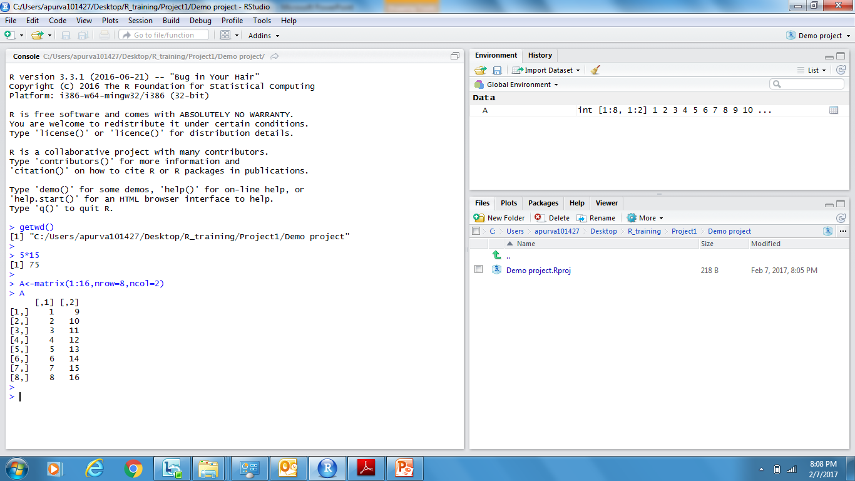
Introduction to R-Studio
R in a more user-friendly environment. It is open-source and available at http://www.rstudio.com/
The usual Rstudio screen has four windows:
Console
Workspace and history
Files, plots, packages and help
The R script(s) and data view (to be covered in the next slide)
Workspace tab shows all the active objects
History tab shows a list of past commands
Files tab shows all the files and folders in the default workspace
Plots tab will show all your graphs
Packages tab will list a series of packages or add-ons needed to run certain processes
Help tab displays documentation
console is where you can type commands and see output

Slide 24
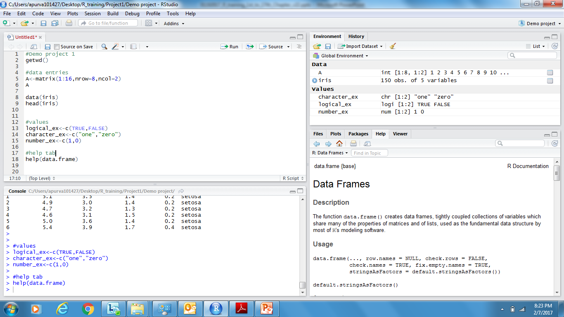
Introduction to R-Studio (contd.)
The R script is where you keep a record of your work.
To create a new R script you can either go to File -> New -> R Script, or click on the icon with the “+” sign and select “R Script”, or simply press Ctrl+Shift+N.
Make sure to save the script
Script: Type R commands and run them. Press Ctrl-R or click on the ‘Run’ icon.

Slide 25
Chapter 2: Vectors
Creating a vector
Repeat Function
Vectorized operations
Replace elements of vectors
Manipulating vectors

Slide 26
Vectors: Assigning a Vector
So far we have worked with scalars (single numbers), but R is designed to work with vectors as well
The function c, which is short for concatenate, can be used to create vectors from scalars or other vectors:
The colon operator ‘:’ can be used to generate a sequence of numbers
You can also use the seq function to create a sequence given the starting and stopping points and an increment. For example here are eleven values between 0 and 1 in steps of 0.1:
> x <- c(1,3,5,7)
> x
[1] 1 3 5 7
> x <- 1:10
> x
[1] 1 2 3 4 5 6 7 8 9 10
> seq(0, 1, 0.1)
[1] 0.0 0.1 0.2 0.3 0.4 0.5 0.6 0.7 0.8 0.9 1.0

Slide 27
Vectors: Repeat function
Another function that is useful in creating vectors is rep for repeat or replicate.
For example, rep(3,4) replicates the number ‘3’ four times
The first argument can be a vector, so rep(x,3) replicates the entire vector x three times
If both arguments are vectors of the same size, then each element of the first vector is replicated the number or times indicated by the corresponding element in the second vector. Consider this example:
The first call repeats the vector 1:3 twice.
The second call repeats each element of 1:3 twice, and could have been written rep(1:3, rep(2,3)), a common R idiom
> rep(3,4)
[1] 3 3 3 3
> x<-c(1,5)
[1] 1 5
> rep(x,3)
[1] 1 5 1 5 1 5
> rep(1:3, 2)
[1] 1 2 3 1 2 3
> rep(1:3, c(2,2,2))
[1] 1 1 2 2 3 3

Slide 28
Vectors: Vectorized Operations
R operations are vectorized
If x is a vector, then log(x) is a vector with the logs of the elements of x
Arithmetic and relational operators also work element by element
If x and y are vectors of the same length, then x + y is a vector with elements equal to the sum of the corresponding elements of x and y
If y is a scalar it is added to each element of x
The logical operators "|" (or) and "&" (and) also work element by element
> x<-c(1,5)
> log(x)
[1] 0.000000 1.609438
> y<-c(2,3)
> x+y
[1] 3 8
> x + 3
[1] 4 8
> a = c(TRUE, TRUE, FALSE, FALSE)
> b = c(TRUE, FALSE, TRUE, FALSE)
> a & b
[1] TRUE FALSE FALSE FALSE

Slide 29
Vectors: Vectorized Operations (caution)
Caution must be exercised while using vectorized operations
Like in the example below, addition of two unequal vectors works. After adding the first 4 corresponding elements of a and b, the 1st and 2nd elements of a are added back to the 5th and 6th elements of b
R shows a warning, but users needs to be cautious
> a<-c(1:4)
> b<-c(1:6)
> a
[1] 1 2 3 4
> b
[1] 1 2 3 4 5 6
> a+b
[1] 2 4 6 8 6 8
Warning message:
In a + b : longer object length is not a multiple of shorter object length

Slide 30
Referencing Elements of Vectors
The number of elements of a vector is returned by the function ‘length’
Individual elements are addressed using subscripts in square brackets, so x[1] is the first element of x, x[2] is the second, and x[length(x)] is the last
The subscript can be a vector itself, so x[1:3] is a vector consisting of the first three elements of x
Negative subscript excludes the corresponding element, so x[-1] returns a vector with all elements of x except the first one
> x<-c(11:20)
> length(x)
[1] 10
> x[1]
[1] 11
> x[2]
[1] 12
> x[length(x)]
[1] 20
> x[1:3]
[1] 11 12 13
> x[-1]
[1] 12 13 14 15 16 17 18 19 20

Slide 31
Referencing Elements of Vectors (contd.)
Subscripts can also be a logical expression, in which case you get the elements for which the expression is TRUE
Example: To list the elements of x that are less than 5, we use
This expression reads ‘x such that x is less than 5’
This works because the subscript “x < 5” is this vector:
R's subscripting facility is extremely powerful. It may take a while to get used to it; eventually, the language becomes natural
> x<-c(1:10)
> x[x < 5]
[1] 1 2 3 4
> x < 5
[1] TRUE TRUE TRUE TRUE FALSE FALSE FALSE FALSE FALSE FALSE

Slide 32
Chapter 3: Lists in R
What are Lists?
Creating a List
List Indexing
Adding and Deleting List Elements
List Concatenation
Size of a List
Accessing List Components and Values
Recursive Lists
Notes:
31

Slide 33
Lists in R
R’s list structure is an ordered collection of data of arbitrary types
Similar to an R vector, an R list is a container for values, but its contents can be items of different data types
List elements are accessed using the list name as well as the element name
Here’s a quick example:
> first_list <- list(num=5, ch="abc")
> first_list
$num
[1] 5
$ch
[1] "abc"
> x$num
[1] 5
Note:
Names – called tags in R literature - of the list elements are optional
Names of list components can be abbreviated to whatever extent is possible without causing ambiguity:
first_list$num can also be referred as first_list$n
Notes:
32

Slide 34
Creating a List
Lists in R can be created using either the list() function or the vector() function
The vector() function however, requires passing an additional parameter, ‘mode’, which tells R to treat it differently from ordinary vectors
Using the list() function
Using the vector() function
> simple_list <- list(sepal.length=5.9, sepal.width=5.0, petal.length=5.1, petal.width=1.8, species='virginica')
> simple_list
$sepal.length
[1] 5.9
$sepal.width
[1] 5
$petal.length
[1] 5.1
$petal.width
[1] 1.8
$species
[1] "virginica"
> simple_list1 <- vector(mode='list')
> simple_list1[['sepal.length']] <- 5.9
> simple_list1[['sepal.width']] <- 5.0
> simple_list1[['spetal.length']] <- 5.1
> simple_list1[['petal.width']] <- 1.8
> simple_list1[['species']] <- 'virginica'
Note
The elements of a list are not limited to atomic types(numeric, character), but, can also be a vector, list, array or a data frame.

Slide 35
List Indexing
List elements can be accessed either through the element name or the element index number
Here’s a quick example to access the 1st element of the list ‘simple_list’ i.e. ‘sepal.length’.
> simple_list$sepal.length
[1] 5.9
> simple_list[["sepal.length"]]
[1] 5.9
> simple_list[[1]]
[1] 5.9
Note:
We can refer to list components by their numerical indices, treating the list as a vector, but by using double brackets instead of single ones
If single brackets [ ] are used, the result is another list—a sub-list of the original
> simple_list[1]
$sepal.length
[1] 5.9
> class(simple_list[[1]])
[1] "numeric"
> class(simple_list[1])
[1] "list"

Slide 36
Adding and Deleting List Elements
New components can be added after a list is created, as shown below:
> simple_list$new <- "new element"
> simple_list$new
[1] "new element"
Adding components can also be done via a vector index:
> simple_list[7:8] <- c("7th element", "8th element")
List elements can be deleted by setting them to NULL
> simple_list[6:8] <- c(NULL,NULL,NULL)
> simple_list
$sepal.length
[1] 5.9
$sepal.width
[1] 5
$petal.length
[1] 5.1
$petal.width
[1] 1.8
$species
[1] "virginica"

Slide 37
List Concatenation
Lists can be concatenated by using the combine function, c().
> mtcars[1:3,2:6]
cyl disp hp drat wt
Mazda RX4 6 160 110 3.90 2.620
Mazda RX4 Wag 6 160 110 3.90 2.875
Datsun 710 4 108 93 3.85 2.320
> iris[4:6,2:4]
Sepal.Width Petal.Length Petal.Width
4 3.1 1.5 0.2
5 3.6 1.4 0.2
6 3.9 1.7 0.4
> list_mtcars<-as.list(mtcars[1:3,2:6])
> list_iris<-as.list(iris[4:6,2:4])
> c(list_mtcars,list_iris)
$cyl
[1] 6 6 4
$disp
[1] 160 160 108
$hp
[1] 110 110 93
$drat
[1] 3.90 3.90 3.85
$wt
[1] 2.620 2.875 2.320
$Sepal.Width
[1] 3.1 3.6 3.9
$Petal.Length
[1] 1.5 1.4 1.7
$Petal.Width
[1] 0.2 0.2 0.4
Note
List elements can be vectors, lists, objects and dataframes, hence the c() operator can be used as a joining operator

Slide 38
Size of List
Size of a list can be determined using the length() function.
Let us find the length of ‘simple_list’ and ‘complex_list’, and compare the sum with the size of concatenated list i.e. ‘combined_list’.
> complex_list<-list(iris$Sepal.Length, iris$Sepal.Width, iris$Petal.Length,
+ iris$Petal.Width, iris$Species) > > combined_list<-c(simple_list,complex_list)
>
> length(simple_list)
[1] 5
> length(complex_list)
[1] 5
> length(combined_list)
[1] 10

Slide 39
Accessing List Components and Values
If the components in a list have tags, these can be identified via names():
> names(simple_list)
[1] "sepal.length" "sepal.width" "petal.length" "petal.width" "species"
The values of a list can also be found using unlist() This function returns a vector, having the same element names as the list.
> unlist(simple_list)
sepal.length sepal.width petal.length petal.width species
"5.9" "5" "5.1" "1.8" "virginica"
> class(unlist(simple_list))
[1] "character"
Where possible, list components are coerced to a common mode during the unlist operation, hence, the result often ends up as a character vector
Vectors are coerced to the highest type of the components in the hierarchy NULL < raw < logical < integer< real < complex < character < list < expression: pair-lists are treated as lists.

Slide 40
Recursive Lists
A list containing other lists as it’s components is called a recursive list. Let us now construct a recursive list
> recursive_list <- list( simple_list, complex_list )
>
> length(recursive_list)
[1] 2
> class(recursive_list[[1]])
[1] "list"
> class(recursive_list[[2]])
[1] "list"
> length(recursive_list[[1]])
[1] 5
> length(recursive_list[[2]])
[1] 5
This code makes ‘recursive_list’ into a two-component list, with each component itself being a list as well
Note:
The list ‘combined_list’ obtained by using the combine function, c(), is not a recursive list

Slide 41
Chapter 4: Matrices and Arrays
introduction to Matrices
Referencing Matrices
Arithmetic Operations
Higher dimensional Arrays – 3D, 4D, etc.

Slide 42
Introduction to Matrices
R also understands matrices and higher dimensional arrays. The following function creates a 3x4 matrix and fills it by columns with the numbers 1 to 12:
The elements of a matrix may be addressed using the row and column subscripts in square brackets, separated by a comma. Thus, M[1,1] is the first element of M
A subscript may be left blank to select an entire row or column:
M[1,] is the first row and M[,1] is the first column of M.
> M = matrix(1:12, nrow=3, ncol=4, byrow=FALSE)
> M
[,1] [,2] [,3] [,4]
[1,] 1 4 7 10
[2,] 2 5 8 11
[3,] 3 6 9 12
> M[1,1]
[1] 1
> M[1,]
[1] 1 4 7 10
> M[,1]
[1] 1 2 3

Slide 43
Referencing Matrices
Any of the subscripts can be a vector, so M[1:2,1:2] returns the upper-left 2 by 2 corner of M.
The number of rows and columns of a matrix are returned by the functions nrow and ncol
Exercise: How do you list the last element of a matrix?
> M[1:2,1:2]
[,1] [,2]
[1,] 1 4
[2,] 2 5
> nrow(M) [1] 3
> ncol(M)
[1] 4

Slide 44
Arithmetic operations on matrices
To transpose a matrix, use the function ‘t’.
The matrix multiplication operator is %*%
Matrix inversion is done by the function ‘solve’.
> L=matrix(1:18,6,3) > L [,1] [,2] [,3]
[1,] 1 7 13
[2,] 2 8 14
[3,] 3 9 15
[4,] 4 10 16
[5,] 5 11 17
[6,] 6 12 18 >
> t(L)
[,1] [,2] [,3] [,4] [,5] [,6]
[1,] 1 2 3 4 5 6
[2,] 7 8 9 10 11 12
[3,] 13 14 15 16 17 18

Slide 45
Arithmetic operations on matrices (contd.)
The matrix multiplication operator is %*%
> L%*%t(L)
[,1] [,2] [,3] [,4] [,5] [,6]
[1,] 219 240 261 282 303 324
[2,] 240 264 288 312 336 360
[3,] 261 288 315 342 369 396
[4,] 282 312 342 372 402 432
[5,] 303 336 369 402 435 468
[6,] 324 360 396 432 468 504
> L2=matrix(19:36,6,3)
> L2
[,1] [,2] [,3]
[1,] 19 25 31
[2,] 20 26 32
[3,] 21 27 33
[4,] 22 28 34
[5,] 23 29 35
[6,] 24 30 36
> L%*%L2 Error in L %*% L2 : non-conformable arguments
> # matrix multiplication rules do not allow for this, hence we have an error

Slide 46
Arithmetic operations on matrices (contd.)
The function * simply multiplies corresponding values with each other
> L
[,1] [,2] [,3]
[1,] 1 7 13
[2,] 2 8 14
[3,] 3 9 15
[4,] 4 10 16
[5,] 5 11 17
[6,] 6 12 18
> L2
[,1] [,2] [,3]
[1,] 19 25 31
[2,] 20 26 32
[3,] 21 27 33
[4,] 22 28 34
[5,] 23 29 35
[6,] 24 30 36
> L*L2
[,1] [,2] [,3]
[1,] 19 175 403
[2,] 40 208 448
[3,] 63 243 495
[4,] 88 280 544
[5,] 115 319 595
[6,] 144 360 648

Slide 47
Arithmetic operations on matrices (contd.)
Scalar Multiplication
Mathematical matrix addition
> 3*L
[,1] [,2] [,3]
[1,] 3 21 39
[2,] 6 24 42
[3,] 9 27 45
[4,] 12 30 48
[5,] 15 33 51
[6,] 18 36 54
> L+L
[,1] [,2] [,3]
[1,] 2 14 26
[2,] 4 16 28
[3,] 6 18 30
[4,] 8 20 32
[5,] 10 22 34
[6,] 12 24 36

Slide 48
Higher dimensional arrays
Matrices are two-dimensional data structures. But suppose we also have data taken at different times, one data point per person per variable per time. ‘Time’ then becomes the third dimension, in addition to rows and columns
In R, such data sets are called arrays
As a simple example, consider students and test scores
Say each test consists of two parts, so we record two scores for a student for each test
Now suppose that we have two tests
Here’s the data for the first test:
Here are the scores for the same students on the second test:
> firsttest
[,1] [,2]
[1,] 46 30
[2,] 21 25
[3,] 50 50
> secondtest
[,1] [,2]
[1,] 46 43
[2,] 41 35
[3,] 50 50

Slide 49
Higher dimensional arrays
Now let’s put both tests into one data structure, which we’ll name tests
It will have two “layers”—one layer per test—with three rows and two columns within each layer
Each element of ‘tests’ now has three subscripts, rather than two as in the matrix case. For instance, the score on the second portion of test 1 for student 3 is retrieved as follows:
Printing an array displays the data layer by layer:
> tests <- array(data=c(firsttest, secondtest), dim=c(3,2,2))
> tests[3,2,1]
[1] 48
> tests
, , 1
[,1] [,2]
[1,] 46 30
[2,] 21 25
[3,] 50 48
, , 2
[,1] [,2]
[1,] 46 43
[2,] 41 35
[3,] 50 49

Slide 50
Chapter 5: DataFrames
Introduction to Dataframes
Referencing dataframes
mtcars dataset
Subset
Filter function
Basic Filtering
Bind functions
Utility functions: rownames, colnames, apply
Merge

Slide 51
Introduction to Data Frames
Intuitively, a data frame is like a matrix, with a two-dimensional, rows and columns structure
It differs from a matrix in that each column may have a different mode (data type)
For instance, one column may consist of numbers, and another column might have character strings
In this example, a data frame is created from two vectors: kids and ages.
While creating a dataframe, by default, stringsAsFactors will be TRUE
This means that if we create a data frame from a character vector (in this case, kids), R will convert the vector to a factor
Since our work with character data will typically be with vectors rather than factors, we’ll set stringsAsFactors to FALSE for now. Strings can be converted back to factors later, if required
> kids <- c("Jack","Jill")
> ages <- c(12,10)
> d <- data.frame(kids,ages, stringsAsFactors=FALSE)
> d # matrix-like display
kids ages
1 Jack 12
2 Jill 10

Slide 52
Referencing Data Frames
Technically, a data frame is a list, with the components of that list being equal-length vectors. Since d is a list, we can access it as such via component index values or component names
> d[[1]]
[1] "Jack" "Jill"
> d$kids
[1] "Jack" "Jill"
> # Referencing like we did with matrices
> d[,1]
[1] "Jack" "Jill"
> str(d)
'data.frame': 2 obs. of 2 variables:
$ kids: chr "Jack" "Jill"
$ ages: num 12 10
Dataframe is the workhorse of R and is used by most of the analytical tools available in R. Let us deep dive now by looking at bigger data samples

Slide 53
Common practice datasets: mtcars
> head(mtcars)
mpg cyl disp hp drat wt qsec vs am gear carb
Mazda RX4 21.0 6 160 110 3.90 2.620 16.46 0 1 4 4
Mazda RX4 Wag 21.0 6 160 110 3.90 2.875 17.02 0 1 4 4
Datsun 710 22.8 4 108 93 3.85 2.320 18.61 1 1 4 1
Hornet 4 Drive 21.4 6 258 110 3.08 3.215 19.44 1 0 3 1
Hornet Sportabout 18.7 8 360 175 3.15 3.440 17.02 0 0 3 2
Valiant 18.1 6 225 105 2.76 3.460 20.22 1 0 3 1
> # Also try summary command
> str(mtcars)
'data.frame': 32 obs. of 11 variables:
$ mpg : num 21 21 22.8 21.4 18.7 18.1 14.3 24.4 22.8 19.2 ...
$ cyl : num 6 6 4 6 8 6 8 4 4 6 ...
$ disp: num 160 160 108 258 360 ...
$ hp : num 110 110 93 110 175 105 245 62 95 123 ...
$ drat: num 3.9 3.9 3.85 3.08 3.15 2.76 3.21 3.69 3.92 3.92 ...
$ wt : num 2.62 2.88 2.32 3.21 3.44 ...
$ qsec: num 16.5 17 18.6 19.4 17 ...
$ vs : num 0 0 1 1 0 1 0 1 1 1 ...
$ am : num 1 1 1 0 0 0 0 0 0 0 ...
$ gear: num 4 4 4 3 3 3 3 4 4 4 ...
$ carb: num 4 4 1 1 2 1 4 2 2 4 ...

Slide 54
Subset Data Frames using rows and columns
# Print the first row of the data
> mtcars[1,]
mpg cyl disp hp drat wt qsec vs am gear carb
Mazda RX4 21 6 160 110 3.9 2.62 16.46 0 1 4 4
# Subset the 2nd to 5th observation
> mtcars[2:5,]
mpg cyl disp hp drat wt qsec vs am gear carb
Mazda RX4 Wag 21.0 6 160 110 3.90 2.875 17.02 0 1 4 4
Datsun 710 22.8 4 108 93 3.85 2.320 18.61 1 1 4 1
Hornet 4 Drive 21.4 6 258 110 3.08 3.215 19.44 1 0 3 1
Hornet Sportabout 18.7 8 360 175 3.15 3.440 17.02 0 0 3 2
# Subset the 2nd to 5th observation and only keep the first 3 columns
> mtcars[2:5,1:3,drop=FALSE]
mpg cyl disp
Mazda RX4 Wag 21.0 6 160
Datsun 710 22.8 4 108
Hornet 4 Drive 21.4 6 258
Hornet Sportabout 18.7 8 360
> head(mtcars$cyl)
[1] 6 6 4 6 8 6

Slide 55
Subset Function
Subset function helps in subsetting using column names. It is used to keep/drop variables
# Using subset for keeping variables
> mtcars_sub<-subset(mtcars,select=c(mpg,cyl))
> head(mtcars_sub)
mpg cyl
Mazda RX4 21.0 6
Mazda RX4 Wag 21.0 6
Datsun 710 22.8 4
Hornet 4 Drive 21.4 6
Hornet Sportabout 18.7 8
Valiant 18.1 6
# Using subset for dropping variables
> mtcars_sub2<-subset(mtcars, select=-c(mpg))
> head(mtcars_sub2)
cyl disp hp drat wt qsec vs am gear carb
Mazda RX4 6 160 110 3.90 2.620 16.46 0 1 4 4
Mazda RX4 Wag 6 160 110 3.90 2.875 17.02 0 1 4 4
Datsun 710 4 108 93 3.85 2.320 18.61 1 1 4 1
Hornet 4 Drive 6 258 110 3.08 3.215 19.44 1 0 3 1
Hornet Sportabout 8 360 175 3.15 3.440 17.02 0 0 3 2
Valiant 6 225 105 2.76 3.460 20.22 1 0 3 1

Slide 56
Filter functions
Just like vectors, dataframes can be filtered using subsetting rules to access the required rows / columns
> mtcars[mtcars$mpg>30,]
name mpg cyl disp hp drat wt qsec vs am gear carb
Fiat 128 Fiat 128 32.4 4 78.7 66 4.08 2.200 19.47 1 1 4 1
Honda Civic Honda Civic 30.4 4 75.7 52 4.93 1.615 18.52 1 1 4 2
Toyota Corolla Toyota Corolla 33.9 4 71.1 65 4.22 1.835 19.90 1 1 4 1
Lotus Europa Lotus Europa 30.4 4 95.1 113 3.77 1.513 16.90 1 1 5 2
> subset(mtcars,gear==5)
name mpg cyl disp hp drat wt qsec vs am gear carb
Porsche 914-2 Porsche 914-2 26.0 4 120.3 91 4.43 2.140 16.7 0 1 5 2
Lotus Europa Lotus Europa 30.4 4 95.1 113 3.77 1.513 16.9 1 1 5 2
Ford Pantera L Ford Pantera L 15.8 8 351.0 264 4.22 3.170 14.5 0 1 5 4
Ferrari Dino Ferrari Dino 19.7 6 145.0 175 3.62 2.770 15.5 0 1 5 6
Maserati Bora Maserati Bora 15.0 8 301.0 335 3.54 3.570 14.6 0 1 5 8
> mtcars[mtcars$gear==5 & mtcars$mpg>25,]
name mpg cyl disp hp drat wt qsec vs am gear carb
Porsche 914-2 Porsche 914-2 26.0 4 120.3 91 4.43 2.140 16.7 0 1 5 2
Lotus Europa Lotus Europa 30.4 4 95.1 113 3.77 1.513 16.9 1 1 5 2
> subset(mtcars,name %in% c("Fiat 128"))
name mpg cyl disp hp drat wt qsec vs am gear carb
Fiat 128 Fiat 128 32.4 4 78.7 66 4.08 2.2 19.47 1 1 4 1

Slide 57
Dataframes bind
rbind : Adds observations to the data frame
Ensure data types of each column is same
cbind : Adds 1 or more columns to a data frame
> add_1<-c(5,140,120,3.9,2.6,16.76,1,1,3,3)
> add_1
[1] 5.00 140.00 120.00 3.90 2.60 16.76 1.00 1.00 3.00 3.00
> mtcars<-rbind(mtcars,add_1)
> dim(mtcars)
[1] 33 11
> rownames(mtcars)[33]<-"New entry"
> tail(mtcars,2)
mpg cyl disp hp drat wt qsec vs am gear carb
Volvo 142E 21.4 4 121.0 109.0 4.11 2.780 18.6 1 1 4 2
New entry 5.0 140 120.0 3.9 2.60 16.760 1.0 1 3 3 5
> #runif generates random numbers
> col_add<-runif(nrow(mtcars))
> mtcars<-cbind(mtcars,col_add)
> head(mtcars,3)
mpg cyl disp hp drat wt qsec vs am gear carb col_add
Mazda RX4 21.0 6 160 110 3.90 2.620 16.46 0 1 4 4 0.7296790
Mazda RX4 Wag 21.0 6 160 110 3.90 2.875 17.02 0 1 4 4 0.9077767
Datsun 710 22.8 4 108 93 3.85 2.320 18.61 1 1 4 1 0.4952811

Slide 58
Utility Functions
rownames : Accessing the names of rows, useful for creating unique keys if unavailable
> name<-rownames(mtcars)
> mtcars<-cbind(name,mtcars)
> head(mtcars,2)
name mpg cyl disp hp drat wt qsec vs am gear carb col_add
Mazda RX4 Mazda RX4 21 6 160 110 3.9 2.620 16.46 0 1 4 4 0.7296790
Mazda RX4 Wag Mazda RX4 Wag 21 6 160 110 3.9 2.875 17.02 0 1 4 4 0.9077767
colnames/names : Accessing the column names of dataframe
> names(mtcars)
[1] "name" "mpg" "cyl" "disp" "hp" "drat" "wt" "qsec" "vs" "am" "gear" "carb" "col_add"
> colnames(mtcars)
[1] "name" "mpg" "cyl" "disp" "hp" "drat" "wt" "qsec" "vs" "am" "gear" "carb" "col_add"
Apply : vectorized function to repeat a calculation on either rows or columns
> apply(mtcars,2,max)
name mpg cyl disp hp drat
"Volvo 142E" "33.9" "140" "472.0" "335.0" "4.93"
wt qsec vs am gear carb
"16.760" "22.90" "1" "3" "5" "8"
col_add
"0.93639703"

Slide 59
Merge DataFrames
Merge: used to join two dataframes
By default, it uses variables with the same name as join key (if join key isn’t specified)
> kids <- c("Jack","Jill","John")
> ages <- c(12,10,13)
> d <- data.frame(kids,ages,stringsAsFactors=FALSE)
> d
kids ages
1 Jack 12
2 Jill 10 3 John 13
> States<-c("NY","TX","CA")
> d2<- data.frame (kids,States,stringsAsFactors=FALSE)
> d2
kids States
1 Jack NY
2 Jill TX
3 John CA
> merged_d<-merge(d,d2)
> merged_d
kids ages States
1 Jack 12 NY
2 Jill 10 TX
3 John 13 CA

Slide 60
Merge DataFrames (contd.)
In most cases, you join two data frames by one or more common key variables
Note:
For joining over more than one key, use by=c(“key1”,”key2”)
For joining over keys having different names, use by.x=“key_x”, by.y=“key_y”
For joining with multiple keys with different names follow this: by.x=c(“key_x1", “key_x2"), by.y=c(“key_y1", “key_y2")
For columns having same names in both x and y dataframes, variable.x and variable.y names are created in the output
> #Syntax
>
> #Outer join
> merge(x = df1, y = df2, by = "key", all = TRUE)
>
> #Left outer join
> merge(x = df1, y = df2, by = "key", all.x = TRUE)
>
> #Right outer join
> merge(x = df1, y = df2, by = "key", all.y = TRUE)
>
> #Cross join
> merge(x = df1, y = df2, by = NULL)

Slide 61
Practice Question
Transport authority suspects that car manufacturers claim unrealistic mileage figures in order to boost sales. The boards wants to investigate but on-ground testing of all vehicles requires lot of manual, legal and financial effort
Prepare a shortlist of 5 cars that you would recommend for testing given the following hold true in decreasing order of importance –
mpg figures above 15 are classified as unrealistic
Automatic vehicles have higher mileage
Heavier vehicles have lower mileage
Lower the number of gears, lower is the mileage

Slide 62
Chapter 6: Handling Factors
Introduction to factors
Changing levels
Drawback
Caution

Slide 63
Introduction to Factors
Factors are variables in R which take on a limited number of different values
The factor function is used to create a factor. The only required argument to factor is a vector of values, which will be returned as a vector of factor values
Both numeric and character variables can be stored as factors, but a factor's levels will always be character values
The levels of a factor represent the unique elements in a factor arranged in an increasing order, by default
> data = c(1,2,2,3,1,2,3,3,1,2,3,3,1)
> fdata = factor(data)
> fdata
[1] 1 2 2 3 1 2 3 3 1 2 3 3 1
Levels: 1 2 3
> data=c("k","l","l","k","a","k","k","a")
> data
[1] "k" "l" "l" "k" "a" "k" "k" "a“
> data1=factor(data)
> data1
[1] k l l k a k k a
Levels: a k l

Slide 64
Changing levels
The levels order can be changed by mentioning levels in the factor command and mentioning a different order
The levels of a factor are used when displaying the factor's values.
You can change these levels at the time you create a factor by passing a vector with the new values through the labels= argument
Note that this changes the actual values of the factor variable
> data=c("k","l","l","k","a","k","k","a")
> factor(data)
[1] k l l k a k k a
Levels: a k l
> factor(data, levels=c("l","a","k"))
[1] k l l k a k k a
Levels: l a k
> data=c("k","l","l","k","a","k","k","a")
> rdata=factor(data,labels=c("I","II","III"))
> rdata
[1] II III III II I II II I
Levels: I II III

Slide 65
Changing levels (contd.)
To change the levels of a factor after it has been created, the assignment form of the levels function is used
To convert the default factor ’fdata’ to roman numerals, use the assignment form of the function:
Factors represent a very efficient way to store character values, because each unique character value is stored only once, and the data itself is stored as a vector of integers
It is very easy to generate a summary for factor variables:
> data = c(1,2,2,3,1,2,3,3,1,2,3,3,1)
> fdata = factor(data)
> levels(fdata) = c('I','II','III')
> fdata
[1] I II II III I II III III I II III III I
Levels: I II III
> summary(factor(data, levels=c("l","a","k"),ordered = TRUE))
l a k
2 2 4

Slide 66
Drawback
In R, there is special type of ordinal data called ordered factor. To create an ordered factor in R, the ‘ordered’ argument in the factor can be used. Ordered factors are useful in making in making comparisons across two similar factors.
One major drawback of factor variables is that even simple arithmetic operations are not possible using numeric factors
factor(data, levels=c("l","a","k"),ordered = TRUE)
[1] k l l k a k k a
Levels: l < a < k
> fert = c(10,20,20,50,10,20,10,50,20)
> fert = factor(fert,levels=c(10,20,50),ordered=TRUE)
> fert
[1] 10 20 20 50 10 20 10 50 20
Levels: 10 < 20 < 50>
>mean(fert)
[1] NA
Warning message:
argument is not numeric or logical:
returning NA in: mean.default(fert)

Slide 67
Solution
In order to perform these mathematical operations a factor needs to be converted to a numeric vector
> mean(as.numeric(levels(fert)[fert]))
[1] 23.33333

Slide 68
Caution
Factors present an efficient way of handling categorical variables, but there are some issues which can creep up inconspicuously
Factors are used in most of the model fitting algorithms directly, so even a minor change in factors levels in your test data w.r.t the train data will make the algorithm scoring incorrect
The levels and the order in which they are defined should match exactly
In case of a new value in the test data, the levels change will happen automatically leading to errors in the scored test data
Use ‘factor’ function to prevent this error
> test_data$variable0<-as.character(test_data$variable0)
> test_data$variable0<-factor(test_data$variable0, + levels=levels(train_data$variable0)
>
> #We can specify levels=c(« value1","value2",……..)

Slide 69
Chapter 7: Import/Export datafiles in R
Importing files into R
Read.table
Text Importing
Exporting data from R

Slide 70
Importing Files into R
Importing files in R is a very easy task. The simplest and the most widely imported files are CSV files:
read.csv(file, header = TRUE, sep = ",", quote = "\"", dec = ".", fill = TRUE, comment.char = "", ...).
List the complete file path, including the file extension
If the first row of our data has column names, we need to specify header=TRUE. If header=FALSE, R assumes column names are not present in the file and it will import the first row as data
Sep indicates the field delimiter
“stringsAsFactors= FALSE” imports strings as categorical variables
If not passed, categorical variables are imported as factors
Variable formats can be checked using the str() function
> mydata1<-read.csv(file="D:/csv.csv")
Note
Tab delimited files- The read.delim function is typically used to import delimited text files
read.delim(file, header=TRUE, sep="\t")
File – A file location
Header – Indicates if the first row describes the column names
Sep – Assigns the delimiter

Slide 71
Read.table
For complex tabular files read.table() is used
The number of arguments are huge and it can be modified to great extent
Read.table is the most generic function for importing files; it can replicate the import of read.csv and read.delim
Importing CSV file using read.csv:
Importing CSV file using read.table:
The output of these functions will be similar
NOTE: This can be replicated for read.delim function. Read.csv and read.delim have different default attributes than read.table function. Read.table is the most raw function of these and can be modified to replicate others.
Column classes can be altered while importing files on R
> read.table(file=“directory/filepath/filename.filetype”, header=TRUE)
> read.csv(file=“directory/filepath/filename.filetype”)
> read.table(file=“directory/filepath/filename.filetype”,sep”,”, header=TRUE)
> read.table(“filename.filetype”, header=TRUE, + colClasses=c(“character”,”integer”…..)

Slide 72
Text Importing
Datasets can be created on the R console directly as well, instead of importing a data file
This feature is useful to create small manual dataframes
> ab<-read.table(header= TRUE, text="
+ a b c12
+ 1 2 exl
+ 23 34 exlserv
+ 123 28278 exlservice")
> ab
a b c12
1 1 2 exl
2 23 34 exlserv
3 123 28278 exlservice

Slide 73
Exporting data from R
In order to store data outside the R environment, write command is often used
For writing a CSV file:
The First attribute indicates the R data frame to be exported
The “file” attribute lists the name of the exported file
Default value of row.names is TRUE. This will generate a CSV file with an indexed row names column
NOTE: Write.table can also be used to export datasets in R
> data(iris) #this is to leverage the in-built iris dataset
> write.csv(iris, file=“name.csv”, row.names=FALSE)

Slide 74
Chapter 8: Operators and Control Flow
Operators in R
Relational Operators
Logical Operators
The ‘if-else’ Construct
Nested ‘if-else’
If-Else Function Call
Ifelse() Function in R
Switch Function
Notes:
73

Slide 75
Operators in R
All binary operators in R are vectorized, i.e. they operate element by element on their arguments, recycling values as needed. These operators include:
+ addition | - subtraction | * multiplication
/ division | ^ exponentiation | %% modulus
 | %/% integer division
Comparison operators will return the logical values TRUE or FALSE, or NA if any elements involved in a comparison are missing
< less than | > greater than | <= l.t. or equal
>= g.t. or equal | == equality | != non-equality
Logical operators come in element-wise as well as pairwise forms
& elementwise and | && pairwise and | ! negation
| elementwise or | || pairwise or | %in% in operator
Notes:
74

Slide 76
Relational Operators
The table below shows the relational operators supported by R. Each element of the first vector is compared with the corresponding element of the second vector. The result of comparison is a Boolean value.
Operator | Description | Example
> | Checks if each element of the first vector is greater than the corresponding element of the second vector. | v <- c(2,5.5,6,9) t <- c(8,2.5,14,9) print(v>t) [1] FALSE TRUE FALSE FALSE
< | Checks if each element of the first vector is less than the corresponding element of the second vector. | v <- c(2,5.5,6,9) t <- c(8,2.5,14,9) print(v < t) [1] TRUE FALSE TRUE FALSE
== | Checks if each element of the first vector is equal to the corresponding element of the second vector. | v <- c(2,5.5,6,9) t <- c(8,2.5,14,9) print(v == t) [1] FALSE FALSE FALSE TRUE
<= | Checks if each element of the first vector is less than or equal to the corresponding element of the second vector. | v <- c(2,5.5,6,9) t <- c(8,2.5,14,9) print(v<=t) [1] TRUE FALSE TRUE TRUE
>= | Checks if each element of the first vector is greater than or equal to the corresponding element of the second vector. | v <- c(2,5.5,6,9) t <- c(8,2.5,14,9) print(v>=t) [1] FALSE TRUE FALSE TRUE
!= | Checks if each element of the first vector is unequal to the corresponding element of the second vector. | v <- c(2,5.5,6,9) t <- c(8,2.5,14,9) print(v!=t) [1] TRUE TRUE TRUE FALSE
Notes:
75

Slide 77
Logical Operators
The below table shows the logical operators supported by R. It is applicable only to vectors of type logical, numeric or complex.
Note: All numbers greater than 1 are considered as logical value TRUE.
Operator | Description | Example
& | Called Element-wise Logical AND operator. It combines each element of the first vector with the corresponding element of the second vector and returns TRUE if both the elements are TRUE | v <- c(3,1,TRUE,2+3i) t <- c(4,1,FALSE,2+3i) print(v&t) [1] TRUE TRUE FALSE TRUE
| | Called Element-wise Logical OR operator. It combines each element of the first vector with the corresponding element of the second vector and returns TRUE if one of the elements is TRUE. | v <- c(3,0,TRUE,2+2i) t <- c(4,0,FALSE,2+3i) print(v|t) [1] TRUE FALSE TRUE TRUE
! | Called Logical NOT operator. Takes each element of the vector and gives the opposite logical value | v <- c(3,0,TRUE,2+2i) print(!v) [1] FALSE TRUE FALSE FALSE
&& | Called Logical AND operator. Takes first element of both vectors and returns TRUE only if both elements are TRUE | v <- c(3,0,TRUE,2+2i) t <- c(1,3,TRUE,2+3i) print(v&&t) [1] TRUE
|| | Called Logical OR operator. Takes first element of both vectors and returns TRUE if at least one element is TRUE | v <- c(0,0,TRUE,2+2i) t <- c(0,3,TRUE,2+3i) print(v||t) [1] FALSE
%in% | This operator is used to identify if an element belongs to a vector. | v1 <- 8; v2 <- 12 t <- 1:10 print(v1 %in% t); print(v2 %in% t) [1] TRUE [1] FALSE
Notes:
76

Slide 78
The ‘if-else’ Construct
The if-else construct facilitates performing different computations depending on whether a programmer-specified Boolean condition evaluates to true or false. Syntax :
if(condition) expression1 else expression2
If the ‘condition’ evaluates to TRUE then ‘expression1’ is evaluated else ‘expression 2’ is evaluated. Here’s a quick example:
> mtcars[1,]
mpg cyl disp hp drat wt qsec vs am gear carb
Mazda RX4 21 6 160 110 3.9 2.62 16.46 0 1 4 4
> if(mtcars$cyl[1]==6) {print("6 cylinder car")}
[1] "6 cylinder car“
Note
(a) The else clause is optional.
(b) ‘expression1’ and ‘expression2’ need not be a single line of code.

Slide 79
Nested ‘if-else’ Clause
Several if-else conditions can also be nested together. Let us see how a nested if-else clause works by modifying the previous example:
> if(mtcars$cyl[1]==6) {
+
+ print("6 cylinder car")
+ } else if (mtcars$cyl[1]==4) {
+
+ print("4 cylinder car")
} else {print("8 cylinder car")}
[1] "6 cylinder car"
While working on R console, the ‘else’ clause should always be preceded by the right brace ‘}’ on the same line
In interactive mode, without braces, the parser would mistakenly take the ‘if-else’ statement to be an ’if’ statement

Slide 80
If-Else Function Call
An if-else statement also works as a function call, and as such, it returns the last value assigned. Let us first have a look at the syntax and then follow it up with an example:
v <- if (cond) expression1 else expression2
This will set ‘v’ to the result of ‘expression1’ or ‘expression2’, depending on whether ‘cond’ is true or false respectively. This construct can effectively be used to write compact codes. Here’s an example:
> mean(mtcars$hp)
[1] 146.6875
> mtcars[1,"hp"]
[1] 110
> power <- if(mtcars[1,"hp"]>=mean(mtcars$hp)) "High!" else "Low!"
> power
[1] "Low!"

Slide 81
Ifelse() in R
The condition in if-else construct seen so far, can’t be applied to vectors. Vectorization of this construct, will be much faster than applying the if-else statement to each element of the vector individually.
Similar to this concept, there is a vector equivalent form of the if-else statement in R, the ifelse() function. Here’s the syntax of ifelse():
ifelse(condition,expression1,expression2)
Let us now demonstrate the use of ifelse() function with the help of an example. An important point to note here is – had we used the simple if-else construct, we would have to iterate the if-else condition for each of the elements of ‘mtcars$hp’ separately.
> ifelse(mtcars$hp[1:10]>mean(mtcars$hp), "high", "low")
[1] "low" "low" "low" "low" "high" "low" "high" "low" "low" "low"

Slide 82
Switch Function
The switch case statement works like the if-else statement but does not perform Boolean assessments. The switch function is very useful when different pre-defined tasks are required to be done in different circumstances. Here’s the syntax of switch() function:
switch(statement, list)
When the switch() function is called, the statement is evaluated and based on this value, the corresponding item in the list is returned. If the value evaluated is a number, that item of the list is returned.
> switch(2,"Mazda RX4","Mazda RX4 Wag","Camaro Z28")
[1] "Mazda RX4 Wag“
> switch(1,"Mazda RX4","Mazda RX4 Wag","Camaro Z28"
[1] "Mazda RX4“
The statement so evaluated may also yield name of the list member.
> measure <- "range"
> switch(measure, mean=mean(mtcars$hp), range=range(mtcars$hp), max=max(mtcars$hp), + min=min(mtcars$hp),"Measure Not Found")
[1] 52 335
> measure <-'a'
> switch(measure, mean=mean(mtcars$hp), range=range(mtcars$hp), + max=max(mtcars$hp),min=min(mtcars$hp),"Measure Not Found")
[1] "Measure Not Found"

Slide 83
Chapter 9 : Loops
Introduction to Loops
For loops
While loops
Repeat loops
Interruption in Loops
Vectorization
Guidelines for usage

Slide 84
Introduction to Loops
Loops are used to execute a block of code several times
Below is a flowchart illustrating the working of a loop statement in most programming languages (and R)
Conditional code
If condition is TRUE
Condition
If condition is FALSE
Loop Type | Function
for loop | Like a while statement, except that it tests the condition at the end of the loop body. Number of iterations are fixed
while loop | Repeats a statement or group of statements while a given condition is true. It tests the condition before executing the loop body.
repeat loop | Executes a sequence of statements multiple times and abbreviates the code that manages the loop variable.

Slide 85
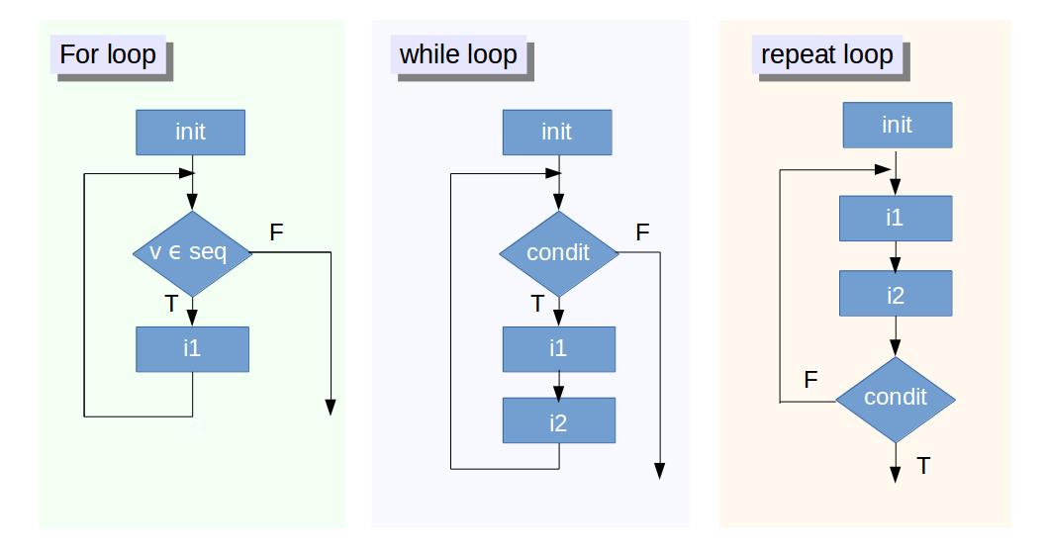
For Loop
Flowchart
One or more initialization instructions within the init rectangle
1
Condition Evaluation
Here, we test whether v’s current value is within a specified range This range is typically defined in the initialization, with something like (say) 1:100 in order to ensure that the loop is started.
2
4
If the condition is verified, a certain instruction – or block of instructions- i1 is executed. Once this is done, the condition is evaluated again, as indicated by the lines going from i1 back to the top, immediately after the init box
3
If the condition is not met (logical false, F in figure) the loop is never executed, as indicated by the loose arrow on the right of the for loop structure. The program will then execute the first instruction found after the loop block.
> #Syntax > for (value in vector) {
> statements
> }

Slide 86
Example – for loops
> Here is an example of a simple for loop
> u1 <- rnorm(30) # create a vector filled with random normal values
> print("This loop calculates the square of the first 10 elements of vector u1")
> usq<-0
> for(i in 1:10)
+ {
+ usq[i]<-u1[i]*u1[i] # i-th element of u1 squared into i-th position of usq
+ print(usq[i])
+ }
+ print(i) > > # Since for loops have fixed no of iterations, for loops may be nested > #Suppose we wish to manipulate a bi-dimensional array by setting its elements to > #specific values; we might do something like this:
> # nested for: multiplication table >
> mymat = matrix(nrow=30, ncol=30) # create a 30 x 30 matrix
+ for(i in 1:dim(mymat)[1]) # for each row
+ {
+ for(j in 1:dim(mymat)[2]) # for each column
+ {
+ mymat[i,j] = i*j # assign values based on position: product of two indexes
+ }
+ }

Slide 87
While loop
Flowchart
One or more initialization instructions
1
2
Condit: The loop exit condition Logical condition which is typically expressed by the comparison between a control variable and a value, by means of greater/less than or equal to, although any expression which evaluates to a logical value, T or F is perfectly legitimate.
3
If the result is TRUE (T), the block of instructions i1 is executed next
i2 serves as a means to exit the loop. It can be:
An update for the control variable, which may alter the result of the condition at the start of the loop
A counter/break mechanism to exit the loop
4
5
When the result is FALSE (F), the loop ends, indicated by the loose arrow on the right of the figure. The program will then execute the first instruction it finds after the loop block.
Note:
If the result is FALSE during the first check (after initialization), the loop is never executed
If this result is never FALSE, the loop never ends
> #Syntax > while (test_expression) {
> statements
> }

Slide 88
Example – while loops
> #For example, the following loop asks the user to enter the correct answer to the > #universe and everything question (from the hitchhiker’s guide to the galaxy), and > #will continue to do so until the user gets it right:
>
> response =1
>
> while (response!=42)
+ {
+ readinteger <- function()
+ {
+ n <- readline(prompt="Please, enter your ANSWER: ")
+ }
+
+ response<-as.integer(readinteger())
+ print("Sorry, the answer to everything MUST be 42");
+ }
As seen in the example, there can be cases where program logic can continue to run because the while condition is not satisfied, this can lead to unwanted running for infinite time, for those cases its better to have a counter and use it to exit using “break;” command when no of iterations become absurdly high

Slide 89
Repeat loop
Flowchart
One or more initialization instructions
1
The block of instructions i1 is executed next
2
The iterations cease once the condition evaluates to true
7
i2 serves as a means to exit the loop. It can be:
An update for the control variable, which may alter the result of the condition at the start of the loop
A counter/break mechanism to exit the loop
3
6
If the result is FALSE (F), the block of instructions i1 is executed next
4
Condit: The loop exit condition Logical condition which is typically expressed by the comparison between a control variable and a value, by means of greater/less than or equal to, although any expression which evaluates to a logical value, T or F is perfectly legitimate.
When the result is TRUE (T), the loop ends, indicated by the loose arrow on the right of the figure. The program will then execute the first instruction it finds after the loop block.
Note:
The instructions in the loop are executed at least once as the loop exit condition is usually at the end of the loop
If this result is never TRUE, the loop never ends
5
> #Syntax > repeat {
> commands > if(condition) { > break > } > }

Slide 90
Example – repeat loops
> readinteger <- function()
+ {
+ n <- readline(prompt="Please, enter your ANSWER: ")
+ }
>
> repeat
+ {
+ response<-as.integer(readinteger())
+ if (response==42){
+ print("Well done!")
+ break
+ }
+ else {print("Sorry, the answer to any question MUST be 42")}
+ }
As seen in the example, there can be cases where program logic can continue to run because the while condition is not satisfied, this can lead to unwanted running for infinite time, for those cases its better to have a counter and use it to exit using “break;” command when no of iterations become absurdly high

Slide 91
Interruption and exit from loops in R
Break
When the R interpreter encounters a break, it will pass control to the instruction immediately after the end of the loop (if any). In case of nested loops, the break will permit to exit only from the innermost loop it is called in.
> # make a lower triangular matrix (zeroes in upper right corner)
> m=10; n=10;
> ctr=0; # used to count the assignemnt
> mymat = matrix(0,m,n) # create a 10 x 10 matrix with zeroes
> for(i in 1:m) {
+ for(j in 1:n)
+ {
+ if(i==j)
+ {
+ break;
+ } else
+ {
+ mymat[i,j] = i*j # we assign the values only when i<>j
+ ctr=ctr+1
+ }
+ }
+ print(i*j)
+ }
> print(ctr)

Slide 92
Interruption and exit from loops in R (contd.)
Next
Next discontinues a particular iteration and jumps to the next cycle (in fact, to the evaluation of the condition holding the current loop). A simpler example of keeping the loop ongoing whilst discarding a particular cycle upon the occurrence of a certain condition is:
> #Code > k=1;
> m=15;
> for (k in 1:m)
+ {
+ if (!k %% 2)
+ next;
+ print(k);
+ }
> #Output [1] 1
[1] 3
[1] 5
[1] 7
[1] 9
[1] 11
[1] 13
[1] 15
The effect here is to print all odd numbers within the interval 1:m (here m=20)
If the remainder of an integer when divided by 2 is 0 (even numbers), the Not operator reverses it to 1, satisfying the if condition – thus skipping all statements that follow the next statement (including the print statement)

Slide 93
Guidelines for use of loops in R
Try to write as little code as possible within the loop – only retain code that needs to be repeated (could significantly reduce runtime)
Be careful when using repeat: ensure that a termination is explicitly set by testing a condition, or an infinite loop may occur
If the code in a loop gets too big, use one or more function calls within the loop; this will make the code easier to follow
R has an extensive collection of native data manipulation functions, which should be leveraged as much as possible
The example shows a loop based bulky implementation vs. a clean vectorized implementation
> #Consider the following case: Addition of two vectors v1 and v2 into a vector v3
> for (i in 1:n)
+ {
+ v3[i] <-v1[i] + v2[i]
+ }
>
> # or using the ‘native’ vectorized form:
> v3 = v1 + v2
[‘native’ because R can recognize all the arithmetic operators as acting on vectors and matrices].

Slide 94
Vectorization
‘Vectorization’ means using single operations on vectors or matrices instead of repeated operations on simple numbers (‘scalars’)
A vector is the elementary data structure in R, a single entity consisting of a collection of things
A collection of numbers is a numeric vector
Combining vectors of the same length gives us a matrix
We can do this vertically or horizontally, using different R instructions. Thus in R, a matrix is seen as a collection of horizontal or vertical vectors. By extension, we can vectorize repeated operations on vectors
Many loop constructs can be made implicit using vectorization.
‘Implicit’ because they do not really disappear; at a lower level, the vectorized form translates into code which could contain loops in the lower level language in which it was compiled (Fortran, C, or C++ )
These (hidden to the user) are usually faster than the equivalent explicit R code

Slide 95
Example : Update DataFrame
> # a bad loop, with 'growing' data
> set.seed(42);
> m=10; n=10;
> mymat<-replicate(m, rnorm(n)) # create matrix of normal random numbers
> mydframe=data.frame(mymat) # transform into data frame
> for (i in 1:m) {
+ for (j in 1:n) {
+ mydframe[i,j]<-mydframe[i,j] + 10*sin(0.75*pi)
+ print(mydframe)
+ }
+ }
> > Here, most of the execution time consists of copying and managing the loop > Let’s see how a vectorized solution looks like:
>
> # vectorized version
> set.seed(42);
> m=10; n=10;
> mymat<-replicate(m, rnorm(n))
> mydframe=data.frame(mymat)
> mydframe<-mydframe + 10*sin(0.75*pi)

Slide 96
Example : Update DataFrame (Time Comparison)
> # measure loop execution
> system.time(
+ for (i in 1:m) {
+ for (j in 1:n) {
+ mydframe[i,j]<-mydframe[i,j] + 10*sin(0.75*pi)
+ }
+ }
+ )
user system elapsed
0.011 0.006 0.023
> # measure vectorized execution
> system.time(
+ mydframe<-mydframe + 10*sin(0.75*pi)
> )
user system elapsed
0.003 0.001 0.003

Slide 97
Chapter 10: Functions
Introduction to User Defined Functions
Argument calling
Scoping
Dynamic Lookup
Nested Functions
Case study
Package

Slide 98
Introduction to Functions
R functions are versatile and can carry a variety of tasks
A lot of operations can be done by built-in functions; you could also create your own functions
To get the list of all built in functions R use builtins(). Some important functions are listed below:
?NA # Help page on handling of missing data values
abs(x) # The absolute value of "x"
append() # Add elements to a
vector c(x) # A generic function which combines its arguments
cat(x) # Prints the arguments
cbind() # Combine vectors by row/column (cf. "paste" in Unix)
diff(x) # Returns suitably lagged and iterated differences
gl() # Generate factors with the pattern of their levels
grep() # Pattern matching
identical() # Test if 2 objects are *exactly* equal
jitter() # Add a small amount of noise to a numeric
vector julian() # Return Julian date
length(x) # Return no. of elements in
vector x ls() # List objects in current environment
paste(x) # Concatenate vectors after converting to character
range(x) # Returns the minimum and maximum of x
rep(1,5) # Repeat the number 1 five times
rev(x) # List the elements of "x" in reverse order
seq(1,10,0.4) # Generate a sequence (1 -> 10, spaced by 0.4)

Slide 99
Introduction to User Defined Functions
User defined functions are a fundamental building block of R and belong to class() “function” in R
Use function() to define a function All R functions have three parts:
The body(), the code inside the function
The formals(), the list of arguments which controls how the function can be called
The environment(), the “map” of the location of the function’s variables
The last expression evaluated in a function is the return value of a function. Sometimes return() argument is used to return the value of a function. Return(value) forces the function to stop execution and return value.
>f <- function(a,b) {a + b}
>f(1,3)
[1] 4
>formals(f)
$a $b
>body(f)
{ a + b }
>environment(f)
<environment: R_GlobalEnv>
Note
Any function in R could be assigned a different name and used accordingly. For example, mean2() (where mean2<- mean) would work the same as mean function.

Slide 100
Argument Calling
A function could either be called by matching the positions or by matching the names.
Positional Matching:
Name Matching is very useful when the order of the arguments in function definition is not known
The last expression evaluated in a function is the return value of a function
Sometimes return() argument is used to return the value of a function
> fun<- function(x,y) {x-y}
> fun(2,3)
[1] -1
> fun(x=3,y=2)
[1] 1
> fun(y=2,x=0)
[1] 2

Slide 101
Lexical Scoping
Scoping describes how R looks up values when given a name. If an argument is not well defined inside a function then R looks up in the global environment.
Consider the following example :
The answer is not 5 because:
f() was defined in the global environment, so the global bindings of a and b which count
Although the function g() defines its own local bindings for a and b, these do not overwrite the global bindings, and are simply not relevant to the evaluation of f()
To use the local values of a and b, consider rewriting the function f() to include arguments a & b as input parameters
> a=1
> b=2 > f<- function(x) { + a*x+b + } > g<- function(x) + { + a=2 + b=1 + f(x) + } > g(2) [1] 4

Slide 102
Dynamic Lookup & … R Functions
Lexical scoping determines where to look for values, not when to look for them. R looks for values when the function is run, not when it’s created. This means that the output of a function can be different depending on objects outside its environment
Sometimes the user may not know the number of arguments that the function needs to be specified in advance. In such cases … can be used in the function arguments while writing the function.
> a<- function(x) { x/5 }
> a(10)
[1] 2
> a(100)
[1] 20
> func1<- function(a1,a2, ...){
+ max(a1,a2, ...) + min(a1,a2, ...)
+ }
> func1(12,45,23,56,789,12)
[1] 801

Slide 103
Nested Functions
Using a function in a body of another leads to nested functions
The same rules apply if a function is defined inside another function: look inside the current function, then where that function was defined, and so on, all the way up to the global environment
> fun1<- function(a,b,c) {
+ a+b+c }
> fun2<-function(x) {
+ a=x/2
+ b=x/3
+ c=x/4
+ return(fun1(a,b,c))
+ }
> fun2(120)
[1] 130 > #Output 2 functions in a single function: > fun3 <- function(x) {
+ a=b=c=x
+ fun1(a,b,c)
+ }
> fun6<- function(x) {
+ return(c(fun2(x),fun3(x)))
+ }
> fun6(120)
[1] 130 360
> #Function within a function > a=7 > b=9 > f<-function(x) {
+ a*x+b
+ }
>
> g<-function(x) {
+ a=1
+ b=2
+ f<-function(x) {
+ b*x+a
+ }
+ f(x)
+ }
> g ( 2 )
[1] 5

Slide 104
Case study (Functions)
Suppose we need to develop a function to collect factor variables from a dataset and generate a matrix of them
Let’s use the CO2 dataset
Variables Type and Treatment are two factor variables in the CO2 dataset
The idea is to develop a data frame of these variables
The function should be as generic as possible, not just limited to this dataset
> str(CO2) 'data.frame': 84 obs. of 5 variables:
$ Plant : Ord.factor w/ 12 levels "Qn1"<"Qn2"<"Qn3"<..: 1 1 1 1 1 1 1 2 2 2 ...
$ Type : Factor w/ 2 levels "Quebec","Mississippi": 1 1 1 1 1 1 1 1 1 1 ...
$ Treatment: Factor w/ 2 levels "nonchilled","chilled": 1 1 1 1 1 1 1 1 1 1 ...
$ conc : num 95 175 250 350 500 675 1000 95 175 250 ...
$ uptake : num 16 30.4 34.8 37.2 35.3 39.2 39.7 13.6 27.3 37.1 ...

Slide 105
Case study contd.
> classfun<- function(data) {
+ cb <- c()
+ a <- c()
+ # Select factor variables and create a data frame “df”
+ for (i in 1:ncol(data)) {
+ if (class(data[,i])=="factor") {
+ a <- c(a,i)
+ cb <- cbind(cb, data[,i])
+ }
+ }
+ df<-data[,a]
+ return(df)
+ } >
> str(classfun(CO2))
Classes ‘nfnGroupedData’, ‘nfGroupedData’, ‘groupedData’ and 'data.frame': 84 obs. of 2 variables:
$ Type : Factor w/ 2 levels "Quebec","Mississippi": 1 1 1 1 1 1 1 1 1 1 ...
$ Treatment: Factor w/ 2 levels "nonchilled","chilled": 1 1 1 1 1 1 1 1 1 1 ...
> str(classfun(iris))
Factor w/ 3 levels "setosa","versicolor",..: 1 1 1 1 1 1 1 1 1 1 ...

Slide 106
Packages
Packages are collections of R functions, data, and compiled code in a well-defined format.
The directory where packages are stored is called a library.
R comes with a standard set of packages. Others are available for download and installation. Once installed, they have to be loaded into the session to be used.
To get the list of all installed packages, run library()
In order to install and run a new package follow the steps:
To install a new package- install.packages(“packagename”)
To use the package, invoke library(“packagename”) command to load it into the current session.
Note: Any package installed once, just needs to be invoked for every new session. There is no need to install it every time.
> install.packages("randomForest")
Installing package into ‘C:/Users/tuhin100847/Documents/R/win-library/3.3’ (as ‘lib’ is unspecified)
trying URL 'https://cran.rstudio.com/bin/windows/contrib/3.3/randomForest_4.6-12.zip' Content type 'application/zip' length 177174 bytes (173 KB)
downloaded 173 KB
package ‘randomForest’ successfully unpacked and MD5 sums checked The downloaded binary packages are in C:\Users\tuhin100847\AppData\Local\Temp\Rtmp2DzDec\downloaded_packages

Slide 107
Chapter 11 -13 : Vectorized loops (apply family)
Introduction to family functions
Apply
Sapply
Lapply

Slide 108
Introduction to apply functions
The apply family pertains to the R base package, and is populated with functions to manipulate slices of data from matrices, arrays, lists and dataframes in a repetitive way
These functions allow crossing the data in a number of ways and avoid explicit use of loop constructs. They act on an input list, matrix or array, and apply a named function with one or several optional arguments
The called function could be:
An aggregating function, like mean or sum (which returns a scalar);
Transforming or sub-setting functions;
Other vectorized functions, which return more complex structures like list, vectors, matrices and arrays
The apply functions form the basis of more complex combinations and helps to perform operations with very few lines of code
The family comprises: apply, lapply, sapply, vapply, mapply, rapply and tapply

Slide 109
Apply()
It operates on arrays (for simplicity we limit here to 2D arrays, or matrices). Syntax: apply(X, MARGIN, FUN, ...)
where:
X is an array (a matrix if the dimension of the array is 2);
MARGIN is a variable defining how the function is applied: when MARGIN=1, it applies over rows, whereas with MARGIN=2, it works over columns.
Noticeably, with the construct MARGIN=c(1,2) it applies to both rows and columns;
FUN is the function we want to apply and can be any R function, including a User Defined Function (more on functions in a separate post).
We will now illustrate the working of these functions.
Let’s construct a 5 x 6 matrix and imagine we want to sum the values of each column: we can write something like
> X<-matrix(rnorm(30), nrow=5, ncol=6)
> apply(X,2 ,sum)

Slide 110
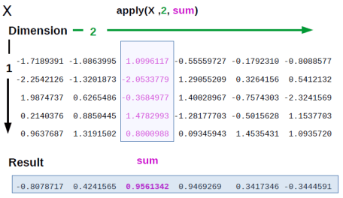
Apply function explanation
Remember that in R a matrix can be seen as a collection of line vectors
when crossing the matrix from top to bottom - along the vertical line 1, which specifies the dimension or margin 1
or as a list of columns vectors, spanning the matrix left to right - along the dimension or margin 2
So the instruction we entered, depicted in figure 1, translates into: apply the function ‘sum’ to the matrix X along margin 2 (meaning column), summing up the values of each column
(To avoid cluttering the picture, we just highlighted one of the columns, the third). We end up with a line vector containing the sums of the values of each column

Slide 111
Lapply()
Lapply function applies the function FUN to each member of a vector or list X and returns a list of the same length as X.
Each element of this resultant list, is the result of applying FUN on the corresponding element of X.
lapply(X, FUN, ...)
If FUN requires additional arguments, it can be passed after specifying X and FUN (...).
Example:
> batch <- list(present = 3, names = c("Abhishek", "Prince", "Swaminathan"), + campus_batch = TRUE)
> lapply(batch, class)
$present
[1] "numeric"
$names
[1] "character"
$campus_batch
[1] "logical"
Here using lapply(), we can easily find out the class of each element in the list named batch
As mentioned, lapply() returned a list. Using unlist() we can convert the list to a vector.
Q: Find out the class of all the elements of ‘batch’ using ‘for loop’. Do you find lapply advantageous ?

Slide 112
Lapply()
Lapply() using Custom Functions:
Lapply can be used with built-in functions as well as custom functions
The custom function can be defined before or inside the lapply function
Example 1:
Example 2:
> bitcoin_price <-list(52629, 52389, + 52147, 53012)
> triple <- function(x) { 3*x }
> lapply(bitcoin_price, triple)
> bitcoin_price <-list(52629, 52389, + 52147, 53012)
> unlist(lapply(bitcoin_price, function(x, factor) {x*factor}, 3))
[[1]]
[1] 157887
[[2]]
[1] 157167
[[3]]
[1] 156441
[[4]]
[1] 159036
[1] 157887 157167 156441 159036

Slide 113
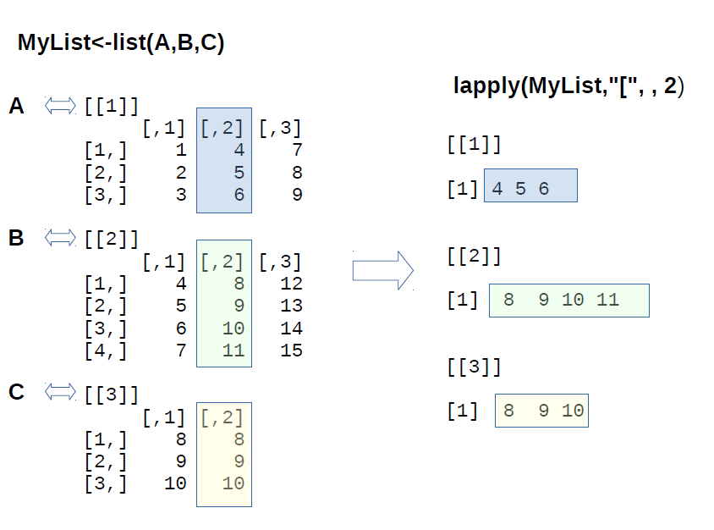
Lapply() Illustration
> #create a list of matrices:
> A<-matrix(1:9, 3,3)
> B<-matrix(4:15, 4,3)
> C<-matrix(8:10, 3,2)
> MyList<-list(A,B,C) # display the list
> # Extract the second column from the
> # list of matrices, using the selection
> # operator "["
> lapply(MyList,"[", , 2)
[[1]]
[1] 4 5 6
[[2]]
[1] 8 9 10 11
[[3]]
[1] 8 9 10
We use the standard selection operator ‘[‘
Then omit the first parameter (which therefore translates into any, that’s why you see the two commas)
Then specify the second parameter, which is 2: our margin is ‘column’
So we extract the second column from all the matrices within the list

Slide 114
Sapply()
Similar to Lapply(), Sapply() applies the function FUN to each member of a vector or list X and returns a vector of the same length as X
Sapply() is very useful when the FUN returns same type of objects
Sapply is a user-friendly version of lapply by default returning a vector or matrix where appropriate
sapply(X, FUN, ...)
Example:
> marks <- list(c(88,91,69,82), c(23, 87,66,68), c(79,57,83,97))
> sapply(marks, mean)
[1] 82.5 61.0 79.0
> marks <- list(c(88,91,69,82), c(23, 87,66,68), c(79,57,83,97))
> identical(sapply(marks,mean), unlist(lapply(marks,mean)))
[1] TRUE

Slide 115
Sapply()
Sapply() using Custom Functions:
Sapply can be used with built-in functions as well as custom functions
Example 1 :
> marks <- list(c(88,91,69,82), c(23, 87,66,68), c(79,57,83,97))
> sapply(marks, function(x){c(min= min(x), max = max(x))})
[,1] [,2] [,3]
min 69 23 57
max 91 87 97
Example 2 :
> identical(sapply(marks, function(x){c(min= min(x), max = max(x))}, simplify = FALSE), lapply(marks, function(x){c(min= min(x), max = max(x))}))
[1] TRUE
In Example 2 , we can see how ‘simplify = FALSE’ changes the result to a list; an identical result to that when we use lapply
Sapply is very similar to Lapply, however it returns a vector rather than a list by default
Setting the attribute “simplify=FALSE” in Sapply will give the same identical output as Lapply

Slide 116
Vapply()
Vapply() is a similar to Sapply(); though behind the scenes it uses lapply() first, and then tries to simplify the result
vapply(X, FUN, FUN.VALUE ...)
Here, The FUN.VALUE argument expects a template for the return argument of this function FUN
Example:
> marks <- list(c(88,91,69,82), c(23, 87,66,68), c(79,57,83,97))
> basics <- function(x) { c(min = min(x), mean = mean(x), max = max(x)) }
> vapply( marks, basics, numeric(3))
[,1] [,2] [,3]
min 69.0 23 57
mean 82.5 61 79
max 91.0 87 97
Q: Can you fix the error in the following code?
> marks <- list(c(88,91,69,82), c(23, 87,66,68), c(79,57,83,97))
> basics <- function(x) { c(min = min(x), mean = mean(x), median = median(x), max = max(x))}
> vapply( marks, basics, numeric(3))

Slide 117
Loops vs. apply functions
Loops
Cross functional coding possiible
Full control over logic flow
Apply Family
Easier Implementation
Faster runtime
Vectorized

Slide 118
Chapter 14: Utilities in R
Importing files into R
Read.table
Text Importing
Exporting data from R
Connecting to Excel workbook
Add Worksheet
Populate Worksheet
Renaming Sheets
Removing Sheets

Slide 119
Some Useful Functions
Help Utilities
Utility | Description | Example
help() | Opens help page for the topic/package specified as argument. (same as ?topic) | > help(help) > help(utils)
apropos() | Displays all objects matching the topic. (same as ??topic) | > apropos("GLM") [1] ".__C__anova.glm" ".__C__anova.glm.null" ".__C__glm" [4] ".__C__glm.null" "glm" "glm.control" [7] "glm.fit“ "predict.glm“ “residuals.glm" [10] "summary.glm"
library( help=packageName) | Displays help on a specific package. | > library(help=stats)
demo() | Runs some demonstrations on R topics/packages. If no topics are specified as arguments, demo() lists all available demos | > demo(recursion)

Slide 120
Some Useful Functions (contd.)
Utility | Description | Example
example() | Run all the R code from the Examples part of R's online help topic | > example(max)
args() | Displays the argument names and corresponding default values of a function. | > args(lm) function (formula, data, subset, weights, na.action, method = "qr", model = TRUE, x = FALSE, y = FALSE, qr = TRUE, singular.ok = TRUE, contrasts = NULL, offset, ...) NULL
functionName | Just writing the name of the function returns the function source code | > lm

Slide 121
Some Useful Functions (contd.)
General Utilities
Utility | Description | Example
getwd() | Returns the current working directory | > getwd()
setwd() | Change the working directory to a specified location | > setwd("C:\EXL")
ls() | List objects in current environment | > ls()
append() | Add elements to a vector | > append(1:5, 0:1, after = 3) [1] 1 2 3 0 1 4 5
identical() | Test if 2 objects are exactly equal | > identical(1, 1.) TRUE
range(x) | Returns the minimum and maximum value. | > range(iris$Sepal.Length) [1] 4.3 7.9
rep(x,n) | Repeats the number x, n times. | > rep(-1,5) [1] -1 -1 -1 -1 -1
rev(x) | Gives the elements of x in reverse order. | > rev(1:5) [1] 5 4 3 2 1

Slide 122
Some Useful Functions (contd.)
General Utilities
Utility | Description | Example
seq(x,y,n) | Generates a sequence: x to y, spaced by n. | > seq(1,20,3) [1] 1 4 7 10 13 16 19
sort(x) | Sorts the vector x. | > sort(mtcars$mpg[1:5]) [1] 18.7 21.0 21.0 21.4 22.8
order(x) | Lists the sorted element numbers of x. | > order(mtcars$mpg[1:5]) [1] 5 1 2 4 3
unique(x) | Removes duplicate entries from vector. | > unique(c(1,2,3,1,2)) [1] 1 2 3
which.max(), which.min() | Determines the location, i.e., index of the (first) minimum or maximum of a numeric (or logical) vector. | > which.max(iris$Sepal.Length) [1] 132 > which.min(iris$Sepal.Length) [1] 14

Slide 123
Mathematical Utilities
Utility | Description | Example
sum() | Returns the sum of all the values present in its arguments. | > sum(iris$Sepal.Length) [1] 876.5
sqrt() | Computes the (principal) square root. | > sqrt(2) [1] 1.414214
abs() | Computes the absolute value. | > abs(-2) [1] 2
log(x),log10() | log computes logarithms, by default natural logarithms, log10 computes common (i.e., base 10) logarithms. The general form log(x, base) computes logarithms with the base base. | > log10(100) [1] 2 > log(100,2) [1] 6.643856
exp() | Computes the exponential function. | > exp(2) [1] 7.389056
cos(),sin(),tan(), acos(), asin(), atan() | Compute the cosine, sine, tangent, arc-cosine, arc-sine, arc-tangent. | > cos(1) [1] 0.5403023
cospi(x), sinpi(x), and tanpi(x) | Compute cos(pi*x), sin(pi*x), and tan(pi*x). | > cospi(1) [1] -1
eigen() | Computes eigenvalues and eigenvectors of numeric (double, integer, logical) or complex matrices. | > eigen(cbind(c(1,-1), c(-1,1))) $values [1] 2 0 $vectors [,1] [,2] [1,] -0.7071068 -0.7071068 [2,] 0.7071068 -0.7071068

Slide 124
Mathematical Utilities(contd.)
Utility | Description | Example
deriv() | Computes derivatives of simple expressions, symbolically. | > deriv(~ x^2, "x") expression({ .value <- x^2 .grad <- array(0, c(length(.value), 1L), list(NULL, c("x"))) .grad[, "x"] <- 2 * x attr(.value, "gradient") <- .grad .value})
integrate() | Adaptive quadrature of functions of one variable over a finite or infinite interval. | > integrate(fun <- function(x) { 2*x},-1,1) 0 with absolute error < 2.2e-14
union(x, y) intersect(x, y) setdiff(x, y) setequal(x, y) is.element(el, set) | Performs set union, intersection, (asymmetric!) difference, equality and membership on two vectors. | > y <- c(sort(sample(3:23, 7))) [1] 7 9 10 11 17 20 22 > x <- c(sort(sample(1:20, 9))) [1] 5 6 8 9 10 11 12 18 19 > union(x, y) [1] 5 6 8 9 10 11 12 18 19 7 17 20 22 > intersect(x, y) [1] 9 10 11 > setdiff(x, y) [1] 5 6 8 12 18 19 > setdiff(y, x) [1] 7 17 20 22 > setequal(x, y) [1] FALSE > is.element(19,x) [1] TRUE

Slide 125
Data Utilities
Utility | Description | Example
is.numeric() | Tests if an object is of type “numeric” | > is.numeric(iris$Sepal.Length) [1] TRUE
as.numeric() | Creates or coerces objects of type "numeric". | > as.numeric(c("-.1"," 2.7 ","B")) [1] -0.1 2.7 NA Warning message: NAs introduced by coercion
is.character() | Tests if an object is of type "character". | > is.character(pi) [1] FALSE
as.character() | Creates objects of type "character". | > as.character(pi) [1] "3.14159265358979"
is.factor() | Tests if an object is of type “factor". | > is.factor(as.factor(LETTERS[3:1])) [1] TRUE
as.factor() | Creates objects of type “factor”. | as.factor(LETTERS[3:1]) [1] C B A Levels: A B C
chartr(old, new, x) | Translates each character in x that is specified in old to the corresponding character specified in new. | > x <- "MiXeD cAsE 123" > chartr("iXs", "why", x) [1] "MwheD cAyE 123"
gsub(p, r, x) | Substitutes the pattern p with replacement r in the string x. | > x <- "R Tutorial" > gsub("ut","ot",x) [1] "R Totorial"
tolower(), toupper() | Converts string to lower/upper case letters. | > tolower("ABC") [1] "abc" > toupper("abc") [1] "ABC"

Slide 126
grep and grepl in R
Base R provides functions such as grep() and grepl() that match character patterns in a specified vector. While both functions find patterns, they return different output types based on those patterns
Grep returns numeric values that correspond to the indexed locations of the patterns
Grepl returns a logical vector in which "TRUE" represents a pattern match.
Here’s the syntax of simplest form of grepl:
where, pattern is the regular expression/string to be matched in the specified vector x.
Let us take an example to illustrate this. Suppose we need to subset the built-in dataset ‘CO2’ based on the values in the column ‘Treatment’.
> grepl(pattern, x)
> filtered_df <- CO2[grep("non",CO2$Treatment),]
> head(filtered_df)
Plant Type Treatment conc uptake
1 Qn1 Quebec nonchilled 95 16.0
2 Qn1 Quebec nonchilled 175 30.4
3 Qn1 Quebec nonchilled 250 34.8
4 Qn1 Quebec nonchilled 350 37.2
5 Qn1 Quebec nonchilled 500 35.3
6 Qn1 Quebec nonchilled 675 39.2

Slide 127
grep and grepl in R (contd.)
Suppose, we need to filter a dataset based on values that do not match a specified pattern. The code can be modified as follows:
Similarly, pattern-matching can also be used to select specific columns of a dataset:
> filtered_df2 <- CO2[-(grep("non",CO2$Treatment)),]
> head(filtered_df2)
Plant Type Treatment conc uptake
22 Qc1 Quebec chilled 95 14.2
23 Qc1 Quebec chilled 175 24.1
24 Qc1 Quebec chilled 250 30.3
25 Qc1 Quebec chilled 350 34.6
26 Qc1 Quebec chilled 500 32.5
27 Qc1 Quebec chilled 675 35.4
> filtered_df3 <- CO2[,grep("T",colnames(CO2))]
> head(filtered_df3)
Type Treatment
1 Quebec nonchilled
2 Quebec nonchilled
3 Quebec nonchilled
4 Quebec nonchilled
5 Quebec nonchilled
6 Quebec nonchilled

Slide 128
grep and grepl in R (contd.)
Here are some regular expressions that can be used for pattern matching.
Syntax | Description
\\d | Digit, 0,1,2 ... 9
\\D | Not Digit
\\s | Space
\\S | Not Space
\\w | Word
\\W | Not Word
\\t | Tab
\\n | New line
^ | Beginning of the string
$ | End of the string
\ | Escape special characters, e.g. \\ is "\", \+ is "+"
| | Alternation match. e.g. /(e|d)n/ matches "en" and "dn"
• | Any character, except \n or line terminator
[ab] | a or b
[^ab] | Any character except a and b
[0-9] | All Digit
[A-Z] | All uppercase A to Z letters
[a-z] | All lowercase a to z letters
[A-z] | All Uppercase and lowercase a to z letters
i+ | i at least one time

Slide 129
grep and grepl in R (contd.)
Here are some regular expressions that can be used for pattern matching.
Syntax | Description
i* | i zero or more times
i? | i zero or 1 time
i{n} | i occurs n times in sequence
i{n1,n2} | i occurs n1 - n2 times in sequence
i{n1,n2}? | non greedy match, see above example
i{n,} | i occures >= n times
[:alnum:] | Alphanumeric characters: [:alpha:] and [:digit:]
[:alpha:] | Alphabetic characters: [:lower:] and [:upper:]
[:blank:] | Blank characters: e.g. space, tab
[:cntrl:] | Control characters
[:digit:] | Digits: 0 1 2 3 4 5 6 7 8 9
[:graph:] | Graphical characters: [:alnum:] and [:punct:]
[:lower:] | Lower-case letters in the current locale
[:print:] | Printable characters: [:alnum:], [:punct:] and space
[:punct:] | Punctuation character: ! " # $ % & ' ( ) * + , - . / : ; < = > ? @ [ \ ] ^ _ ` { | } ~
[:space:] | Space characters: tab, newline, vertical tab, form feed, carriage return, space
[:upper:] | Upper-case letters in the current locale
[:xdigit:] | Hexadecimal digits: 0 1 2 3 4 5 6 7 8 9 A B C D E F a b c d e f

Slide 130
Basic Error Handling Functions in R
warning() The warning() function generates a warning message that corresponds to its argument(s) and (optionally) the expression or function from which it was called. The following code defines the function testit() such that whenever testit() is called, a warning message is generated.
stop() The stop() function stops execution of the current expression and executes an error action. Here’s an example: | suppressWarnings() The suppressWarnings() function, as the name suggests, suppresses a warning message. Let us look at an example:
> testit <- function() warning("testit")
> testit()
Warning message:
In testit() : testit
> iter <- 12
> try(if(iter > 10) stop("too many iterations"))
Error in try(if (iter > 10) stop("too many iterations")) : too many iterations
> testit <- function() warning("testit")
> testit()
Warning message:
In testit() : testit
> suppressWarnings(testit())

Slide 131
Dates and Times in R
R provides several options for dealing with date and date/time data
To get the current date, use Sys.Date() function
Internally, R stores date/time objects as the number of days since January 1, 1970, using negative numbers for earlier dates. The as.numeric function can be used to convert a date object to its internal form
There are three built-in date/time classes in R:
Date: This class can be used, only with dates, but not with times.
POSIXct: This is usually the best class to use, when handling time in your data (ct stands for calendar time).
POSIXlt: This class enables easy extraction of specific components of a time (lt stands for local time). It is also worth remembering that these are list objects
Apart from these built-in date/time classes, packages such as ‘chron’ augment the available alternatives
> Sys.Date()
[1] "2017-01-08"
> as.numeric(Sys.Date())
[1] 17174

Slide 132
Creating Date Class Objects in R
The built-in as.Date function is used to create Date class objects
The as.Date function allows a variety of input formats through the ‘format’ argument
The default format is a four digit year, followed by a month, then a day, separated by either dashes or slashes
The following example shows a date format which as.Date accepts by default:
If your input dates are not in the standard format, a format string can be composed using the elements shown below
> dt1 <- as.Date("2012-07-22")
> dt1
[1] "2012-07-22“
> dt2 <- as.Date("04/20/2011", format = "%m/%d/%Y")
> dt2
[1] "2011-04-20“
> dt3 <- as.Date("October 6, 2010", format = "%B %d, %Y")
> dt3
[1] "2010-10-06"

Slide 133
Date Format reference list
%a | Abbreviated weekday name in the current locale on this platform
%A | Full weekday name in the current locale. (Also matches abbreviated name on input.)
%b | Abbreviated month name in the current locale on this platform. (Also matches full name on input: in some locales there are no abbreviations of names.)
%B | Full month name in the current locale. (Also matches abbreviated name on input.)
%c | Date and time. Locale-specific on output, "%a %b %e %H:%M:%S %Y" on input.
%C | Century (00–99): the integer part of the year divided by 100.
%d | Day of the month as decimal number (01–31).
%D | Date format such as %m/%d/%y: the C99 standard says it should be that exact format (but not all OSes comply).
%e | Day of the month as decimal number (1–31), with a leading space for a single-digit number.
%F | Equivalent to %Y-%m-%d (the ISO 8601 date format).
%g | The last two digits of the week-based year (see %V). (Accepted but ignored on input.)
%G | The week-based year (see %V) as a decimal number. (Accepted but ignored on input.)
%h | Equivalent to %b.
%H | Hours as decimal number (00–23). As a special exception strings such as 24:00:00 are accepted for input, since ISO 8601 allows these.
%I | Hours as decimal number (01–12).
%j | Day of year as decimal number (001–366).
%m | Month as decimal number (01–12).
%M | Minute as decimal number (00–59).
%n | Newline on output, arbitrary whitespace on input.
%p | AM/PM indicator in the locale. Used in conjunction with %I and not with %H. An empty string in some locales
%r | The 12-hour clock time (using the locale's AM or PM). Only defined in some locales.
%R | Equivalent to %H:%M.
%S | Second as integer (00–61), allowing for up to two leap-seconds (but POSIX-compliant implementations will ignore leap seconds).
%t | Tab on output, arbitrary whitespace on input.
%T | Equivalent to %H:%M:%S.
%u | Weekday as a decimal number (1–7, Monday is 1).
%U | Week of the year as decimal number (00–53) using Sunday as the first day 1 of the week (and typically with the first Sunday of the year as day 1 of week 1). The US convention.
%V | Week of the year as decimal number (01–53) as defined in ISO 8601. If the week (starting on Monday) containing 1 January has four or more days in the new year, then it is considered week 1. Otherwise, it is the last week of the previous year, and the next week is week 1. (Accepted but ignored on input.)
%w | Weekday as decimal number (0–6, Sunday is 0).
%W | Week of the year as decimal number (00–53) using Monday as the first day of week (and typically with the first Monday of the year as day 1 of week 1). The UK convention.
%x | Date. Locale-specific on output, "%y/%m/%d" on input.
%X | Time. Locale-specific on output, "%H:%M:%S" on input.
%y | Year without century (00–99). On input, values 00 to 68 are prefixed by 20 and 69 to 99 by 19 – that is the behaviour specified by the 2004 and 2008 POSIX standards, but they do also say ‘it is expected that in a future version the default century inferred from a 2-digit year will change’.
%Y | Year with century. Note that whereas there was no zero in the original Gregorian calendar, ISO 8601:2004 defines it to be valid (interpreted as 1BC): see https://en.wikipedia.org/wiki/0_(year). Note that the standards also say that years before 1582 in its calendar should only be used with agreement of the parties involved.

Slide 134
Calculations with Date Class Objects in R
A number of calculations can be performed on Date-class objects:
Difference between dates:
The difftime() can be used to specify the unit(months, weeks etc.) for difference between two dates. Here’s a quick example:
Days can be added/subtracted to the date object using the +/- operator. Let us look at some examples:
> dt1 - dt2
Time difference of 459 days
> difftime(dt1, dt2, units = "weeks")
Time difference of 65.57143 weeks
> dt2 + 10
[1] "2011-04-30“
> dt2 - 10
[1] "2011-04-10"

Slide 135
Calculations with Date Class Objects in R
Create a vector of dates:
The combine function c() can be used to create a vector of dates
Create a sequence of dates:
The seq() function can be used to build a sequence of dates by specifying three arguments:
start-date
the length of sequence
the increment factor(using the ‘by’ keyword)
> three_dates <- c(dt1,dt2,dt3)
> three_dates
[1] "2012-07-22" "2011-04-20" "2010-10-06“.
> six.weeks <- seq(dt1, length = 6, by = "week")
> six.weeks
[1] "2012-07-22" "2012-07-29" "2012-08-05" "2012-08-12" "2012-08-19" "2012-08-26"
> six.biweeks <- seq(dt1, length = 6, by = 14)
> six.biweeks
[1] "2012-07-22" "2012-08-05" "2012-08-19" "2012-09-02" "2012-09-16" "2012-09-30"
> six.biweeks <- seq(dt1, length = 6, by = "2 weeks")
> six.biweeks
[1] "2012-07-22" "2012-08-05" "2012-08-19" "2012-09-02" "2012-09-16" "2012-09-30"

Slide 136
Examples with dates:
> ##find the difference between dates > dt1 - dt2
Time difference of 459 days
> difftime(dt1, dt2, units = "weeks")
Time difference of 65.57 weeks > ## Add or subtract days:
> dt2 + 10
[1] "2011-04-30“
> dt2 – 10 [1] "2011-04-10“ > ##create a vector of dates and find the intervals between them:
> three.dates <- as.Date(c("2010-07-22", "2011-04-20", "2012-10-06"))
> three.dates [1] "2010-07-22" "2011-04-20" "2012-10-06“ > diff(three.dates)
> ## Time differences in days
[1] 272 535create a sequence of dates:
>
> six.weeks <- seq(dt1, length = 6, by = "week")
> six.weeks [1] "2012-07-22" "2012-07-29" "2012-08-05" "2012-08-12" "2012-08-19" "2012-08-26" > six.weeks <- seq(dt1, length = 6, by = 14)
> six.weeks [1] "2012-07-22" "2012-08-05" "2012-08-19" "2012-09-02" "2012-09-16“ "2012-09-30“ > six.weeks <- seq(dt1, length = 6, by = "2 weeks")

Slide 137
Creating POSIXct Class Objects in R
POSIXct functions are used to store UNIX time stamp data
The as.POSIXct function allows a variety of input formats through the ‘format’ argument
The following example shows date-time which as.POSICXct will accept by default:
Note: The default system time zone is included in the output. However, an alternate time zone can be specified using the ‘tz’ argument:
Similar, to as.Date(), a format string can be composed for unstandardized date-time formats:
> tm1 <- as.POSIXct("2013-07-24 23:55:26")
> tm1
[1] "2013-07-24 23:55:26 IST"
> tm2 <- as.POSIXct("2010-12-01 11:42:03", tz = "GMT")
> tm2
[1] "2010-12-01 11:42:03 GMT"
> tm3 <- as.POSIXct("25072013 08:32:07", format = "%d%m%Y %H:%M:%S")
> tm3
[1] "2013-07-25 08:32:07 IST"

Slide 138
Calculations with POSIXct Class Objects in R
A number of calculations can be performed on POSIXct-class objects:
Comparison between times: POSIXct class objects can be compared using the relational operators built-in in R:
Addition or Subtraction of seconds: Seconds can be added/subtracted to the date class object using the +/- operator. Let us look at the examples:
Note: Unit of addition/subtraction in case of Date class was days, whereas, for POSIXct class objects is seconds.
> tm1>tm2
[1] TRUE
> tm1+30
[1] "2013-07-24 23:55:56 IST"
> tm1-30
[1] "2013-07-24 23:54:56 IST"

Slide 139
Calculations with POSIXct Class Objects in R (contd.)
Difference between times: Difference between times can be found using the ‘-’ operator
As seen previously, the difftime() function can also be used
Note: Difference between objects with different time-zones can also be found
> tm1-tm2
Time difference of 966.2801 days
> difftime(tm1,tm2, units="secs")
Time difference of 83486603 secs

Slide 140
POSIXlt Class Objects in R
POSIXlt class objects in R store date-time objects in the form of a list
This class enables easy extraction of specific components of time
Similar to as.Date() and as.POSIXct(), the as.POSIXlt() is used to create POSIXlt objects:
The elements of POSIXlt class objects can be easily obtained by extracting the required list element:
POSIXlt class object can be truncated or rounded-off using the trunc(). Here, are some example:
> unlist(tm1.lt)
sec min hour mday mon year wday yday isdst zone gmtoff
"26" "55" "23" "24" "6" "113" "3" "204" "0" "IST" NA
> tm1.lt <- as.POSIXlt("2013-07-24 23:55:26")
> tm1.lt
[1] "2013-07-24 23:55:26 IST"
> trunc(tm1.lt, "days")
[1] "2013-07-24 IST"
> trunc(tm1.lt, "mins")
[1] "2013-07-24 23:55:00 IST"

Slide 141
Chapter 15: Data Cleaning
Introduction to Data cleaning
Introduction of tidyr
Gathering columns into key-value pairs
Separating columns
Merging Columns
Type Conversions
Working with Dates
String Manipulation
Univariate and bivariate distributions
Missing Values
Outliers
Summarize the data

Slide 142

Introduction to data cleaning
While it is usually assumed that data are in the correct state for data analysis. In practice, a data analyst spends significant time preparing the data before carrying out any statistical operation
Data Cleaning is the process of transforming raw data into consistent data that can be analyzed. It is aimed at improving the quality of statistical assessments that will subsequently be carried out.
Data cleaning may profoundly influence the results of analyses.
For this reason, data cleaning should be considered a statistical operation, to be performed in a reproducible manner. The R statistical environment provides a good environment for reproducible data cleaning since all cleaning actions can be scripted and therefore reproduced

Slide 143
Data Cleaning Steps
Data as it comes in from the source
May lack headers, contain wrong data types, wrong category labels, unknown or unexpected character encoding and so on
Reading such files into an R data frame directly is either difficult or impossible without some sort of preprocessing
Data Cleaning Steps
Raw data
Type check, normalize
Technically correct data
After preprocessing, data is deemed Technically correct
In this state, data can be read into R data frames, with correct names, types and labels, with ease
However, the values could be erroneous or incomplete
For example, an age variable may be reported negative, an under-aged person may be registered to possess a driver's license or data may simply be missing
Fix and impute
Consistent data
Estimate, analyze, derive, etc
Consistent data is the stage where data is ready for statistical inference.
This is the starting point for most statistical testing
Technically, such testing can be carried out without taking previous data cleaning steps into account
In practice however, data cleaning methods like imputation of missing values could significantly influence statistical results; hence, must be accounted for
Statistical Results
Tabulate, plot
Formatted Output

Slide 144
Introduction to tidyr
The tidyr package by Hadley Wickham is designed to help you tidy your data.
It contains four functions that alter the layout of tabular data sets, while preserving the values and relationships contained in the data sets.
The two most important functions in tidyr are gather() and spread(). Each relies on the idea of a key value pair.
Key value pair
A key value pair is a simple way to record information. A pair contains two parts: a key that explains what the information describes, and a value that contains the actual information.
So for example,
Password: 0123456789 would be a key value pair.
0123456789 is the value, and it is associated with the key Password.

Slide 145
Gathering columns
gather() takes multiple columns, and gathers them into key-value pairs: it makes “wide” data longer.
Here’s an example how you might use gather() on a made-up dataset. In this experiment we’ve given three people two different drugs and recorded their heart rate:
> messy <- data.frame(
+ name = c("Wilbur", "Petunia", "Gregory"),
+ a = c(67, 80, 64),
+ b = c(56, 90, 50)
+ )
> messy
name a b
1 Wilbur 67 56
2 Petunia 80 90
3 Gregory 64 50
> messy %>%
+ gather(drug, heartrate, a:b)
name drug heartrate
1 Wilbur a 67
2 Petunia a 80
3 Gregory a 64
4 Wilbur b 56
5 Petunia b 90
6 Gregory b 50

Slide 146
Separating columns in R
Sometimes two variables are clumped together in one column. The function separate() allows you to get them apart
Example:
We have some measurements of how much average time people spend on their phones, measured at two locations (work and home), at two different months. Each person has been randomly assigned to either treatment or control
> set.seed(10)
> messy <- data.frame(
+ id = 1:4,
+ trt = sample(rep(c('control', 'treatment'), each = 2)),
+ work.M1 = runif(4),
+ home.M1 = runif(4),
+ work.M2 = runif(4),
+ home.M2 = runif(4)
+ )
>
> messy
id trt work.M1 home.M1 work.M2 home.M2
1 1 treatment 0.08513597 0.6158293 0.1135090 0.05190332
2 2 control 0.22543662 0.4296715 0.5959253 0.26417767
3 3 treatment 0.27453052 0.6516557 0.3580500 0.39879073
4 4 control 0.27230507 0.5677378 0.4288094 0.83613414
>

Slide 147
Separating columns in R (contd.)
To tidy this data, we first use gather() to turn columns work.T1, home.T1, work.T2 and home.T2 into a key-value pair of key and time. (Only the first 5 rows are shown)
> tidier <- messy %>%
+ gather(key, time, -id, -trt)
> tidier %>% head(5)
id trt key time
1 1 treatment work.M1 0.08513597
2 2 control work.M1 0.22543662
3 3 treatment work.M1 0.27453052
4 4 control work.M1 0.27230507
5 1 treatment home.M1 0.61582931
Next we use separate() to split the key into location and time, using a regular expression to describe the character that separates them.
> tidy <- tidier %>%
+ separate(key, into = c("location", “month"), sep = "\\.")
> tidy %>% head(5)
id trt location month time
1 1 treatment work M1 0.08513597
2 2 control work M1 0.22543662
3 3 treatment work M1 0.27453052
4 4 control work M1 0.27230507
5 1 treatment home M1 0.61582931
>

Slide 148
Special values
R has a few special values that are exceptions to the normal values of a type: NA, NULL, ±Inf and NaN
Value | Description
NA | Stands for Not Available NA is a placeholder for a missing value All basic operations in R handle NA without crashing and mostly return NA whenever one of the input arguments is NA The function is.na can be used to detect NAs
NULL | NULL is special since it has no class (its class is NULL) and has length 0 so it does not take up any space in a vector The function is.null can be used to detect NULL variables
Inf | Stands for infinity and only applies to vectors of class numeric. A vector of class integer can never be Inf. This is because Inf in R is directly derived from the international standard for floating point arithmetic 1 Technically, Inf is a valid number that results from calculations like division of a number by zero Since Inf is numeric, operations between Inf and finite numerics are well-defined and comparison operators work as expected
NaN | Stands for Not a Number. This is generally the result of a calculation of which the result is unknown, but is surely not a number Operations like 0/0, Inf-Inf and Inf/Inf result in NaN. Technically, NaN is of class numeric, which may seem odd since it is used to indicate that something is not numeric. Computations involving numbers and NaN always result in NaN, The function is.nan can be used to detect NaN's.

Slide 149
From technically correct data to consistent data
Consistent data are technically correct data that are fit for statistical analysis. They are data in which missing values, special values, (obvious) errors and outliers are either removed, corrected or imputed.
In record consistency: no contradictory information is stored in a single record
cross-record consistency: statistical summaries of different variables do not conflict
cross-dataset consistency : dataset that is currently analyzed is consistent with other datasets pertaining to the same subject matter
Detection
Selection of the field causing inconsistency
Correction of erroneous fields
One establishes which constraints are violated
For example, an age variable is constrained to non-negative values
This is trivial in the case of a univariate demand as in the previous step, but may be more cumbersome when cross-variable relations are expected to hold
This may be done through deterministic (model-based) or stochastic methods
For example, the marital status of a child must be unmarried. In the case of a violation, it is not immediately clear whether age, marital status or both are wrong

Slide 150
Type Conversions
Type conversions in R work as you would expect. For example, adding a character string to a numeric vector converts all the elements in the vector to character
Data conversion in R works on coercion
Commands to identify type of columns
is.numeric(), is.character(), is.vector(), is.matrix(), is.data.frame()
Commands to convert as.numeric(), as.character(), as.vector(), as.matrix(), as.data.frame)
 | to one long vector | to matrix | to data frame
from vector | c(x,y) | cbind(x,y) rbind(x,y) | data.frame(x,y)
from matrix | as.vector(mymatrix) |  | as.data.frame(mymatrix)
from data frame |  | as.matrix(myframe)

Slide 151
String Manipulation Functions
Although R is a statistical language with numeric vectors and matrices playing a central role, character strings are surprisingly important as well
Ranging from birth dates stored in medical research data files to text-mining applications, character data arises quite frequently in R programs.
Accordingly, R has a number of string-manipulation utilities :
grep()
The call grep(pattern,x) searches for a specified substring pattern in a vector x of strings. If x has n elements—that is, it contains n strings—then grep(pattern,x) will return a vector of length up to n. Each element of this vector will be the index in x at which a match of pattern as a substring of x[i]) was found
> #Here’s an example of using grep: > grep("Pole",c("Equator","North Pole","South Pole"))
[1] 2 3
> grep("pole",c("Equator","North Pole","South Pole"))
integer(0)

Slide 152
String Manipulation Functions (contd.)
nchar()
The call nchar(x) finds the length of a string x
Also note that the results of nchar() will be unpredictable if x is not in character mode. For instance, nchar(NA) turns out to be 2, and nchar(factor("abc")) is 1
For more consistent results on nonstring objects, use Hadley Wickham’s stringr package on CRAN
paste()
The function paste(...) concatenates several strings, returning the result as one long string
Here’s an example:
> nchar("South Pole")
[1] 10
>##Here are some examples:
> paste("North","Pole")
[1] "North Pole"
> paste("North","Pole",sep="")
[1] "NorthPole"
> paste("North","Pole",sep=".")
[1] "North.Pole"
> paste("North","and","South","Poles")
[1] "North and South Poles"

Slide 153
String Manipulation Functions (contd.)
sprintf()
The call sprintf(...) assembles a string from parts in a formatted manner.
It is ntended to evoke string print for “printing” to a string rather than to the screen
substr()
The call substr(x,start,stop) returns the substring in the given character position range start:stop in the given string x.
strsplit()
The call strsplit(x,split) splits a string x into an R list of substrings based on another string split in x.
># Here’s a simple example:
> i <- 8
> s <- sprintf("the square of %d is %d",i,i^2)
> s
[1] "the square of 8 is 64"
># Here’s an example:
> substring("Equator",3,5)
[1] "uat"
> ## Here’s an example:
> strsplit("6-16-2011",split="-")
[[1]]
[1] "6" "16" "2011"

Slide 154
String Manipulation Functions (contd.)
regexpr()
The call regexpr(pattern,text) finds the character position of the first instance of pattern within text, as in this example:
gregexpr()
The call gregexpr(pattern,text) is the same as regexpr(), but it finds all instances of pattern. Here’s an example:
> regexpr("uat","Equator")
[1] 3
> gregexpr("iss","Mississippi")
[[1]]
[1] 2 5

Slide 155
Exploratory Analysis functions in R
Univariate | Categorical | Count, Count%
 |  | Pie Chart, Bar chart
 | Numerical | Min, max, mean, median, mode
 |  | Range, quantile, variance, Standard deviation, Coefficient of variation
 |  | Skewness, Kurtosis
 |  | Histogram, Boxplot
Bivariate | Categorical vs categorical | Chi-squared test
 |  | Bar chart, 2-Y axis plots
 | Numerical vs Numerical | Correlation
 |  | Scatter Plot
 | Categorical vs Numerical | Z-test, t test, ANOVA
 |  | Bar and line chart, 2-Y axis plot

Slide 156
Univariate Distributions
summary()
Summary function automatically calculates a basic univariate distribution of a variable / dataframe
quantile()
Used to calculate the percentile distribution of a variable
> summary(mtcars$mpg)
Min. 1st Qu. Median Mean 3rd Qu. Max.
10.40 15.42 19.20 20.09 22.80 33.90
> quantile(mtcars$mpg,c(0,0.1,0.2,0.3,0.4,0.5,0.6,0.7,0.8,0.9,1))
0% 10% 20% 30% 40% 50% 60% 70% 80% 90% 100%
10.40 14.34 15.20 15.98 17.92 19.20 21.00 21.47 24.08 30.09 33.90

Slide 157
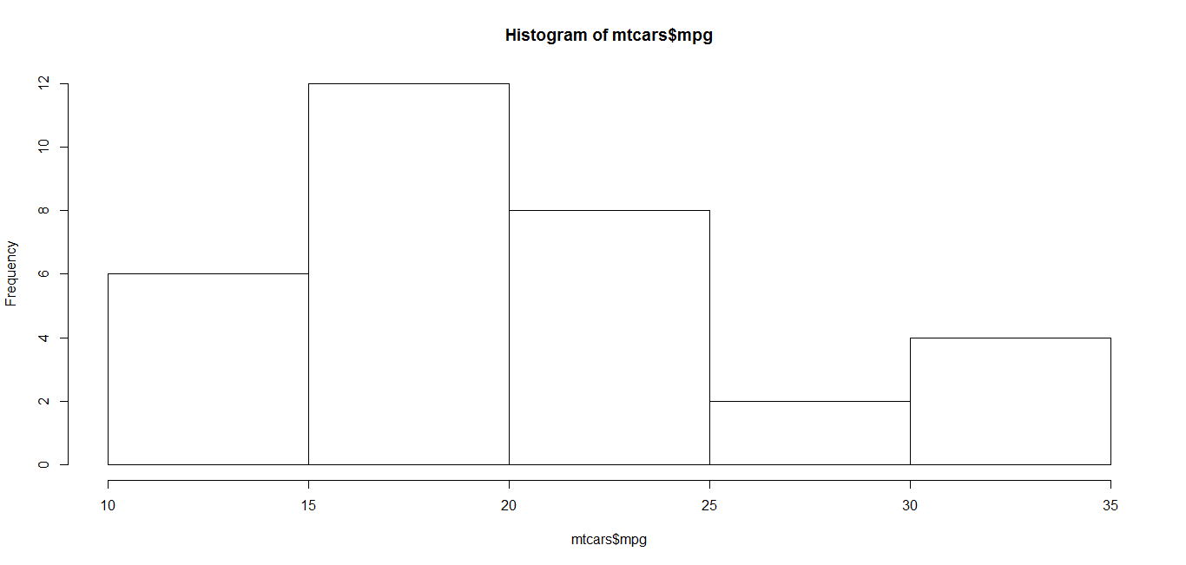
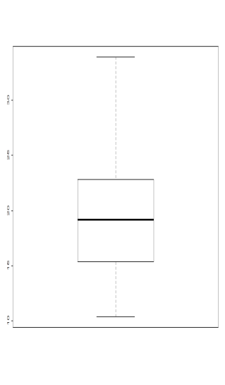
Univariate Plots
hist()
Used to plot a histogram
boxplot()
Used to plot a box plot
> hist(mtcars$mpg, plot=TRUE)
> boxplot(mtcars$mpg)

Slide 158
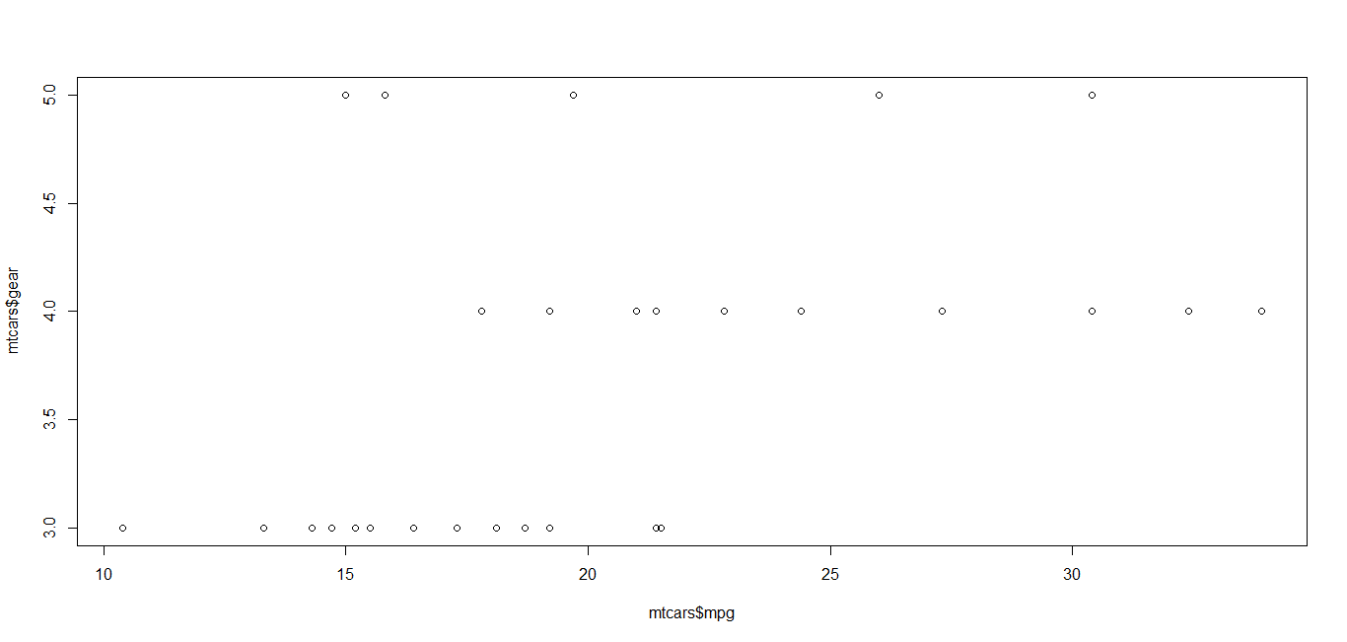
Bivariate Distributions
Scatter Plot
> plot(mtcars$mpg, mtcars$gear)

Slide 159
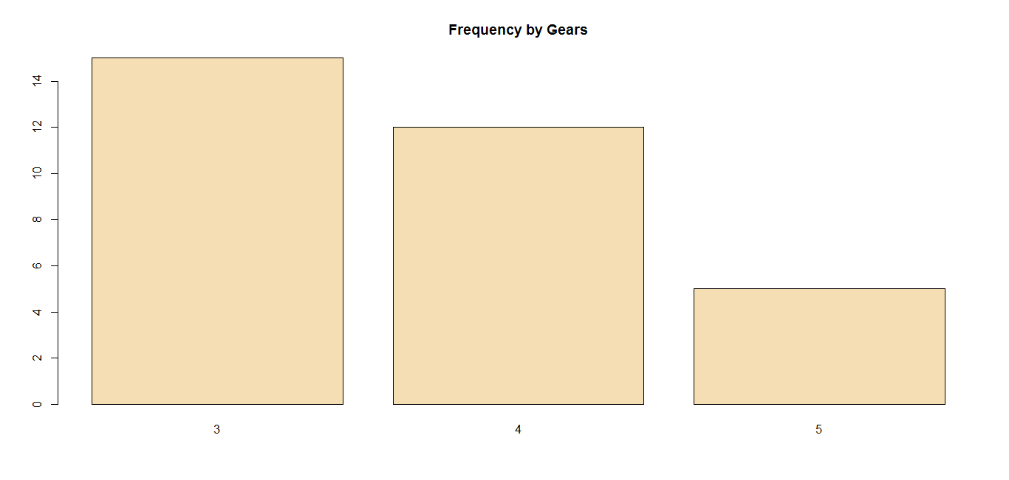
Bivariate Charts
Bar Plot
> barplot(table(mtcars$gear),col='wheat', main="Frequency by Gears")

Slide 160
Table()
Table() produces a summary of counts of occurrences of one variable vs. another
This can be used for bivariate analysis for categorical variables
For numerical variables, use the plot() function instead of table()
> table(CO2$Type,CO2$Treatment)
nonchilled chilled
Quebec 21 21
Mississippi 21 21
> plot(iris$Species,iris$Sepal.Width)

Slide 161
Missing Values
Represented by NA in R, missing values are placeholders for data of which the type is known but its value isn't
One may choose to either omit elements from a dataset that contain missing values or to impute a value, but this is something to be dealt with prior to any analysis.
Common Mistakes
In practice, analysts may confuse a missing value with a default value or category
Another commonly encountered mistake is to confuse an NA in categorical data with the category unknown. If unknown is indeed a category, it should be added as a factor level so it can be appropriately analyzed.
The behavior of R's core functionality is completely consistent with the idea that the analyst must decide what to do with missing data.
A common choice, namely `leave out records with missing data' is supported by many base functions through the na.rm option
> age <- c(23, 16, NA)
> mean(age)
[1] NA
> mean(age, na.rm = TRUE)
[1] 19.5

Slide 162
Missing Value Identification
Here is an elegant way to find the count of missing values in a dataframe
Using other packages to get similar results:
> sapply(airquality, function(x) sum(is.na(x)))
Ozone Solar.R Wind Temp Month Day
37 7 0 0 0 0
> library(mice) > library(VIM)
> md.pattern(airquality)
Wind Temp Month Day Solar.R Ozone
111 1 1 1 1 1 1 0
35 1 1 1 1 1 0 1
5 1 1 1 1 0 1 1
2 1 1 1 1 0 0 2
0 0 0 0 7 37 44

Slide 163
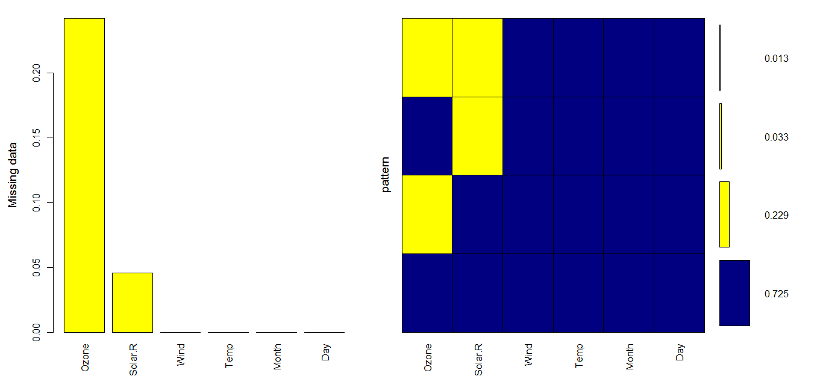
Graphical Representation
> mice_plot <- aggr(airquality, col=c('navyblue','yellow'),numbers=TRUE, sortVars=TRUE, labels=names(airquality), , ylab=c("Missing data","pattern"))
Variables sorted by number of missings:
Variable Count
Ozone 0.24183007
Solar.R 0.04575163
Wind 0.00000000
Temp 0.00000000
Month 0.00000000
Day 0.00000000

Slide 164
Missing Value Imputation
Technique | Description
Impute with mean/ median / mode | Replace missing values by mean/median/mode of the variable. These type of imputations significantly distort the variable distributions, reducing the standard deviation, should be use after checking the pre and post processing univariate distributions
Exponential smoothening | Useful in time-series forecasting, use exponential smoothening to impute missing values
Stochastic Imputation | Use regression techniques to impute the missing values
Do not Impute | Drop the variable if a large percentage of values are missing
Impute to default | For variables which have very few unique values, impute missing values with default (most occurring values)
Business Sense | For some variables, which have apparent obvious correlations, use business sense for imputation

Slide 165
Imputation with mean/median/mode
Mean | df$var<-ifelse(is.na(df$var),mean(df$var,na.rm=T),df$var)
Median | df$var<-ifelse(is.na(df$var),median(df$var,na.rm=T),df$var)
Mode | df$var<-ifelse(is.na(df$var),mode(df$var,na.rm=T),df$var)
Imputation with business sense
For cases where variable meanings and their relationships allow easy imputations. Some examples are:
Name of spouse for unmarried
Number of children for kids
Default amount for bucket 0 customers

Slide 166
Stochastic Imputation: MICE package
MICE (Multivariate Imputation via Chained Equations) is one of the commonly used package by R users.
Creating multiple imputations as compared to a single imputation (such as mean) takes care of uncertainty in missing values.
MICE assumes that the missing data are Missing at Random (MAR), which means that the probability that a value is missing depends only on observed value and can be predicted using them. It imputes data on a variable by variable basis by specifying an imputation model per variable.
Suppose we have ‘k’ variables: X1, X2….Xk. If X1 has missing values, then it will be regressed on all other variables “X2” to “Xk”.
The missing values in X1 will be then replaced by predictive values obtained.
Precisely, the methods used by this package are:
PMM (Predictive Mean Matching) – For numeric variables
logreg(Logistic Regression) – For Binary Variables( with 2 levels)
polyreg(Bayesian polytomous regression) – For Factor Variables (>= 2 levels)
Proportional odds model (ordered, >= 2 levels)

Slide 167
Stochastic Missing Value Imputation
> airquality_n<-mice(airquality, m=5, maxit=50, method="pmm", seed=700)
> summary(airquality_n)
Multiply imputed data set
Call:
mice(data = airquality, m = 5, method = "pmm", maxit = 50, seed = 706)
Number of multiple imputations: 5
Missing cells per column:
Ozone Solar.R Wind Temp Month Day
37 7 0 0 0 0
Imputation methods:
Ozone Solar.R Wind Temp Month Day
"pmm" "pmm" "pmm" "pmm" "pmm" "pmm"
VisitSequence:
Ozone Solar.R
1 2
PredictorMatrix:
Ozone Solar.R Wind Temp Month Day
Ozone 0 1 1 1 1 1
Solar.R 1 0 1 1 1 1
Wind 0 0 0 0 0 0
Temp 0 0 0 0 0 0
Month 0 0 0 0 0 0
Day 0 0 0 0 0 0
Random generator seed value: 700

Slide 168
Do not Impute
For categorical variables, it is better to treat all the missing values as a separate group / level to capture any prediction power they might have
For variables having a lot of missing values (greater than 5%-10%), it is better to drop the variables from the analysis
Impute by default value
For some indicator/categorical variables, we can replace missing values by their default value

Slide 169
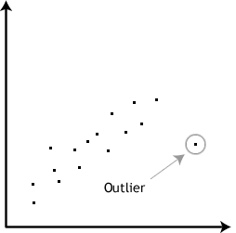
Outliers
An outlier is an observation that lies an abnormal distance from other values in a random sample from a population. In a sense, this definition leaves it up to the analyst (or a consensus process) to decide what will be considered abnormal.
Before abnormal observations can be singled out, it is necessary to characterize normal observations
Often a outlier is present due to the measurements error. Therefore, one of the most important task in data analysis is to identify and (if is necessary) to remove the outliers.
Outliers can lead to erroneous fitting in regression
They can skew the results in exploratory analyses
Hence, they should be removed from the dataset before any meaningful analysis is done

Slide 170
Outliers pros/cons
REASONS FOR OUTLIERS:
Errors
– Data errors
– Sampling error
– Standardization failure
– Faulty distributional assumptions
– Human Error
Genuine Outliers Outliers at random
WHY DO WE CARE ABOUT OUTLIERS?
Outliers are BAD
– The presence of outliers can lead to inflated error rates and substantial distortions of results that can lead to wrong conclusions and inferences.
Outliers are GOOD
– The outliers can provide useful information in the data, for example, a spike in spend behavior of some customers may prove to be the
deciding factor in marketing response campaigns. So care should be taken while dealing with outliers.
In short, outliers are important and hence should not be ignored.

Slide 171
Outlier Treatment Strategies
 | Capping & Flooring | Exponential Smoothening | Sigma approach | Robust Regression | Mahanobis Distance
Outlier Identification | Multiples of P99 and P1 | Extrapolation of distribution | Multiple of standard deviation fro mean | Assigning weights to observations | Mahanobis distance from origin
Outlier Treatment | Capping and Flooring at multiples of P99 and P1 | Boundary condition of exponential function | Capping and flooring at multiples of standard deviation from mean | Outliers ignored in modeling | Outliers given lower Weights
Advantages | Easy to understand and implement Run time is less | Rank ordering Considers distribution | Easy to understand and implement | Effect of outliers minimized | Effect of outliers minimized

Slide 172
Summarization and Aggregation
aggregate() Splits the data into subsets, computes summary statistics for each, and returns the result in a convenient form
Syntax : aggregate (dataframe$column, by=list(), FUN)
Various types of tables
> aggregate(mtcars$mpg, by=list(mtcars$gear), mean)
Group.1 x
1 3 16.10667
2 4 24.53333
3 5 21.38000
>
> mytable <- table(A,B) # A will be rows, B will be columns > mytable # print table > margin.table(mytable, 1) # A frequencies (summed over B) > margin.table(mytable, 2) # B frequencies (summed over A) > prop.table(mytable) # cell percentages > prop.table(mytable, 1) # row percentages > prop.table(mytable, 2) # column percentages

Slide 173
Chapter 16: Data Manipulation with dplyr
Data Manipulation using dplyr
Grouping and aggregation in dplyr
Group by
Summarize
Chaining operations using Pipes
Joining dataframe in dplyr
Primary and Secondary keys
Multi- Variable Keys
Basic Join
Variations on Joins
Inner joins and Full Joins
semi_join() and anti_join()
Multiple Joins
Binds
Bind Rows and Columns

Slide 174
Data Manipulation using dplyr
Dplyr aims to provide a function for each basic verb of data manipulation:
filter() (and slice())
arrange()
select() (and rename())
distinct()
mutate() (and transmute())
summarize()
sample_n() (and sample_frac())
The syntax and function of all these verbs are very similar:
The first argument is a data frame
The subsequent arguments describe what to do with the data frame. Notice that you can refer to columns in the data frame directly without using $.
The result is a new data frame

Slide 175
Filter rows with filter()
Filter() allows you to select a subset of rows in a data frame
The first argument is the name of the data frame
The second and subsequent arguments are the expressions that filter the data frame:
This is equivalent to the more verbose code in base R:
Filter() works similarly to subset() except that you can give it any number of filtering conditions, which are joined together with & (not && which is easy to do accidentally!).
You can also use other boolean operators:
> filter(mtcars, mpg>24, gear>3)
mpg cyl disp hp drat wt qsec vs am gear carb
1 24.4 4 146.7 62 3.69 3.190 20.00 1 0 4 2
2 32.4 4 78.7 66 4.08 2.200 19.47 1 1 4 1
3 30.4 4 75.7 52 4.93 1.615 18.52 1 1 4 2
4 33.9 4 71.1 65 4.22 1.835 19.90 1 1 4 1
5 27.3 4 79.0 66 4.08 1.935 18.90 1 1 4 1
6 26.0 4 120.3 91 4.43 2.140 16.70 0 1 5 2
7 30.4 4 95.1 113 3.77 1.513 16.90 1 1 5 2
mtcars[mtcars$mpg>24 & mtcars$gear>3, ]
filter(mtcars, gear == 1 | gear == 2)

Slide 176
Arrange rows by arrange()
Arrange() takes the name of a data frame, and a set of column names (or more complicated expressions) to order by as attributes
If more than one column name is provided, each additional column will be used to break ties in the values of preceding columns
> head(arrange(mtcars, gear, mpg))
mpg cyl disp hp drat wt qsec vs am gear carb
1 10.4 8 472.0 205 2.93 5.250 17.98 0 0 3 4
2 10.4 8 460.0 215 3.00 5.424 17.82 0 0 3 4
3 13.3 8 350.0 245 3.73 3.840 15.41 0 0 3 4
4 14.3 8 360.0 245 3.21 3.570 15.84 0 0 3 4
5 14.7 8 440.0 230 3.23 5.345 17.42 0 0 3 4
6 15.2 8 275.8 180 3.07 3.780 18.00 0 0 3 3
> #use desc() for Descending
> head(arrange(mtcars, desc(gear), mpg))
mpg cyl disp hp drat wt qsec vs am gear carb
1 15.0 8 301.0 335 3.54 3.570 14.6 0 1 5 8
2 15.8 8 351.0 264 4.22 3.170 14.5 0 1 5 4
3 19.7 6 145.0 175 3.62 2.770 15.5 0 1 5 6
4 26.0 4 120.3 91 4.43 2.140 16.7 0 1 5 2
5 30.4 4 95.1 113 3.77 1.513 16.9 1 1 5 2
6 17.8 6 167.6 123 3.92 3.440 18.9 1 0 4 4

Slide 177
Select columns with select()
Select() allows users to rapidly zoom in on a useful subset using operations that usually only work on numeric variable positions:
> tail(select(mtcars, am:carb))
am gear carb
Porsche 914-2 1 5 2
Lotus Europa 1 5 2
Ford Pantera L 1 5 4
Ferrari Dino 1 5 6
Maserati Bora 1 5 8
Volvo 142E 1 4 2
Rename columns with rename()
> head(rename(mtcars, n_am=am))
mpg cyl disp hp drat wt qsec vs n_am gear carb
Mazda RX4 21.0 6 160 110 3.90 2.620 16.46 0 1 4 4
Mazda RX4 Wag 21.0 6 160 110 3.90 2.875 17.02 0 1 4 4
Datsun 710 22.8 4 108 93 3.85 2.320 18.61 1 1 4 1
Hornet 4 Drive 21.4 6 258 110 3.08 3.215 19.44 1 0 3 1
Hornet Sportabout 18.7 8 360 175 3.15 3.440 17.02 0 0 3 2
Valiant 18.1 6 225 105 2.76 3.460 20.22 1 0 3 1

Slide 178
Create variables using mutate()
Besides selecting sets of existing columns, it’s often useful to add new columns that are functions of existing columns. This is the job of mutate():
The key difference between mutate() and transform() {package:base} is that mutate allows you to refer to columns that you’ve just created
> head(mutate(mtcars,var_new=gear*carb, var_new2=var_new+wt))
mpg cyl disp hp drat wt qsec vs am gear carb var_new var_new2
1 21.0 6 160 110 3.90 2.620 16.46 0 1 4 4 16 18.620
2 21.0 6 160 110 3.90 2.875 17.02 0 1 4 4 16 18.875
3 22.8 4 108 93 3.85 2.320 18.61 1 1 4 1 4 6.320
4 21.4 6 258 110 3.08 3.215 19.44 1 0 3 1 3 6.215
5 18.7 8 360 175 3.15 3.440 17.02 0 0 3 2 6 9.440
6 18.1 6 225 105 2.76 3.460 20.22 1 0 3 1 3 6.460

Slide 179
Summarize()
It performs standard operations on the dataframe; collapsing a data frame to a single row
> summarize(mtcars, mean(mpg))
mean(mpg)
1 20.09062
Randomly sample rows with sample_n() and sample_frac()
Use sample_n() and sample_frac() to take a random sample of rows
Use sample_n() for a fixed number and sample_frac() for a fixed fraction
Use replace = TRUE to perform a bootstrap sample
If needed, you can weight the sample with the weight argument

Slide 180
Grouped Operations in dplyr
Grouping affects the verbs as follows:
Grouped select() is the same as ungrouped select(), except that grouping variables are always retained
Grouped arrange() orders first by the grouping variables
Mutate() and filter() are most useful in conjunction with window functions (like rank(), or min(x) == x)
They are described in detail in vignette("window-functions")
Sample_n() and sample_frac() sample the specified number/fraction of rows in each group
Slice() extracts rows within each group
Summarize() is powerful and easy to understand

Slide 181
“Group by” Example
> by_gear<-group_by(mtcars,gear)
> head(by_gear)
Source: local data frame [6 x 12]
Groups: gear [2]
car mpg cyl disp hp drat wt qsec vs am gear carb
<fctr> <dbl> <dbl> <dbl> <dbl> <dbl> <dbl> <dbl> <dbl> <dbl> <dbl> <dbl>
1 Mazda RX4 21.0 6 160 110 3.90 2.620 16.46 0 1 4 4
2 Mazda RX4 Wag 21.0 6 160 110 3.90 2.875 17.02 0 1 4 4
3 Datsun 710 22.8 4 108 93 3.85 2.320 18.61 1 1 4 1
4 Hornet 4 Drive 21.4 6 258 110 3.08 3.215 19.44 1 0 3 1
5 Hornet Sportabout 18.7 8 360 175 3.15 3.440 17.02 0 0 3 2
6 Valiant 18.1 6 225 105 2.76 3.460 20.22 1 0 3 1
>
> gear_summary<-summarize(by_gear, count=n(), mpg=mean(mpg), weight=mean(wt))
> gear_summary
# A tibble: 3 × 4
gear count mpg weight
<dbl> <int> <dbl> <dbl>
1 3 15 16.10667 3.892600
2 4 12 24.53333 2.616667
3 5 5 21.38000 2.632600
>

Slide 182
Chained operations “pipe”
The pipe operator in R, represented by %>% can be used to chain code together
It is very useful when you are performing several operations on data, and don’t want to save the output at each intermediate step
Example: Suppose we need to find the count of cars and averages of mpg, disp, wt for all cars having gears less than 5, grouped by gears and carb
> mtcars %>% filter(gear<5) %>% group_by(gear,carb) %>% summarize(count=n(), + mean_mpg=mean(mpg), mean_disp=mean(disp), mean_wt=mean(wt))
Source: local data frame [7 x 6]
Groups: gear [?]
gear carb count mean_mpg mean_disp mean_wt
<dbl> <dbl> <int> <dbl> <dbl> <dbl>
1 3 1 3 20.33333 201.0333 3.046667
2 3 2 4 17.15000 345.5000 3.560000
3 3 3 3 16.30000 275.8000 3.860000
4 3 4 5 12.62000 416.4000 4.685800
5 4 1 4 29.10000 84.2000 2.072500
6 4 2 4 24.75000 121.0500 2.683750
7 4 4 4 19.75000 163.8000 3.093750

Slide 183
Primary key
A primary key is a special database column (or combination of columns) designated to uniquely identify all table records.
A primary key’s main features are:
It must contain a unique value for each row of data
It cannot contain null values
A primary key is either an existing table column or a column that is specifically generated by the database according to a defined sequence
Secondary key A given table may have more than just one choice for a primary key. Basically, there may be another column (or combination of columns for a multi-column primary key) that qualify as primary keys.
Any combination of column(s) that may qualify to be a primary key are known as candidate keys. This is because they are considered candidates for the primary key. And the options that are not selected to be the primary key are known as secondary keys.
Example, month, date, per_num, flight_company, etc.

Slide 184
Joining dataframes in dplyr
Dplyr package offers functions to join two dataframes in multiple ways:
> monitors <- read.table(header=TRUE, text='
+ monitorid lat long
+ 1 42.467573 -87.810047
+ 2 42.049148 -88.273029
+ 3 39.110539 -90.324080
+ ')
>
> pollutants <- read.table(header=TRUE, text='
+ pollutant duration monitorid
+ ozone 1h 1
+ so2 1h 1
+ ozone 8h 2
+ no2 1h 4
+ ')
> monitors
monitorid lat long
1 1 42.46757 -87.81005
2 2 42.04915 -88.27303
3 39.11054 -90.32408
> > pollutants
pollutant duration monitorid
1 ozone 1h 1
2 so2 1h 1
3 ozone 8h 2
4 no2 1h 4
>

Slide 185
Merging in R
Below is a list of merging functions in dplyr that combine two data frames into one, also referred to as mutating joins.
Inner Join
This function combines the columns from both data frames, but only keeps rows where the value in the key column matches in both data frames. Below we do an inner join on our two data frames.
For example,
> library(dplyr)
>
> inner_join(pollutants, monitors, by = "monitorid")
pollutant duration monitorid lat long
1 ozone 1h 1 42.46757 -87.81005
2 so2 1h 1 42.46757 -87.81005
3 ozone 8h 2 42.04915 -88.27303
Note that there is only one record for monitor 1 in the monitors data frame, but the information for that monitor is repeated in the output because there is more than one monitor id with the value 1 in the pollutants data frame

Slide 186
Merging in R (contd.)
Left Join
If we want to keep all of the pollutant information, even if there wasn’t a corresponding record in the monitors data frame, then we could use the left_join() function.
> left_join(pollutants, monitors, by = "monitorid") pollutant duration monitorid lat long
1 ozone 1h 1 42.46757 -87.81005
2 so2 1h 1 42.46757 -87.81005
3 ozone 8h 2 42.04915 -88.27303
4 no2 1h 4 NA NA
Full Join
We can also keep all records from both data frames using the full_join() function
> full_join(pollutants, monitors, by = "monitorid")
pollutant duration monitorid lat long
1 ozone 1h 1 42.46757 -87.81005
2 so2 1h 1 42.46757 -87.81005
3 ozone 8h 2 42.04915 -88.27303
4 no2 1h 4 NA NA
5 <NA> <NA> 3 39.11054 -90.32408

Slide 187
Filtering joins with dplyr
Sometimes we would like to subset, or filter, a data frame based on the contents of another data frame. In this kind of task we aren’t combining two data frames, so it’s not a mutating join. We are filtering, so these are called filtering joins
semi_join(): Suppose we want to keep the pollutants data frame in the same format, but only keep records that also have a match in the monitors data frame (without picking any columns from monitors). We can use the semi_join() function to filter the pollutants data frame
anti_join(): We may also want to know what records are in a data frame that do not match the records in another data frame. Suppose we want to know which monitors from the monitors data frame that are not also in the pollutants data frame, we can use the anti_join() function.
> semi_join(pollutants, monitors, by = "monitorid")
pollutant duration monitorid
1 ozone 1h 1
2 so2 1h 1
3 ozone 8h 2
> anti_join(monitors, pollutants, by = "monitorid")
monitorid lat long
1 3 39.11054 -90.32408

Slide 188
Differing Keys
The dplyr merging functions will merge two data frames on multiple columns with differing names. Below we create two data frames for illustration
These two data frames can only be merged if we join on two keys, the column with state information and the column with site information
> sites <- read.table(header=TRUE, text='
+ state site lat long
+ IL 1 42.467573 -87.810047
+ IL 2 42.049148 -88.273029
+ IN 1 41.68140 -87.49473
+ ')
>
> parameters <- read.table(header=TRUE, text='
+ region monitor parameter duration
+ IL 1 ozone 1h
+ IN 1 so2 1h
+ IL 2 ozone 8h
+ IL 2 no2 1h
+ ')
> sites
state site lat long
1 IL 1 42.46757 -87.81005
2 IL 2 42.04915 -88.27303
3 IN 1 41.68140 -87.49473 > >
> parameters
region monitor parameter duration
1 IL 1 ozone 1h
2 IN 1 so2 1h
3 IL 2 ozone 8h
4 IL 2 no2 1h

Slide 189
Differing Keys (Example)
Those two columns have different names in the two data frames. We can do a full join of these two data frames if we supply the names of the keys in the by parameter.
> full_join(sites, parameters, by = c("state" = "region", "site" = "monitor"))
state site lat long parameter duration
1 IL 1 42.46757 -87.81005 ozone 1h
2 IL 2 42.04915 -88.27303 ozone 8h
3 IL 2 42.04915 -88.27303 no2 1h
4 IN 1 41.68140 -87.49473 so2 1h

Slide 190
Set Operations
The final type of two-table verb is set operations. These expect the x and y inputs to have the same variables, and treat the observations like sets:
Intersect(x, y): return only observations in both x and y
Union(x, y): return unique observations in x and y
Setdiff(x, y): return observations in x, but not in y
Let us go over the functions with these examples
> # Given this simple data:
> (df1 <- data_frame(x = 1:2, y = c(1L, 1L)))
> # A tibble: 2 x 2
> x y
> <int> <int>
> 1 1 1
> 2 2 1
> (df2 <- data_frame(x = 1:2, y = 1:2))
> # A tibble: 2 x 2
> x y
> <int> <int>
> 1 1 1
> 2 2 2

Slide 191
Set Operations (Examples)
intersect(df1, df2)
> # A tibble: 1 x 2
> x y
> <int> <int>
> 1 1 1 >
># Note that we get 3 rows, not 4
> union(df1, df2)
> # A tibble: 3 x 2
> x y
> <int> <int>
> 1 2 2
> 2 2 1
> 3 1 1
> setdiff(df1, df2)
> # A tibble: 1 x 2
> x y
> <int> <int>
> 1 2 1
> setdiff(df2, df1)
> # A tibble: 1 x 2
> x y
> <int> <int>
> 1 2 2

Slide 192
Bind in dplyr
Efficiently bind multiple data frames by row and column
Usage
bind_rows(..., .id = NULL) bind_cols(...) combine(...)
one <- mtcars[1:4, ]
two <- mtcars[11:14, ]
# You can either supply data frames as arguments
bind_rows(one, two)
# Or a single argument containing a list of data frames
bind_rows(list(one, two))
bind_rows(split(mtcars, mtcars$cyl))
# When you supply a column name with the `.id` argument, a new
# column is created to link each row to its original data frame
bind_rows(list(one, two), .id = "id")
bind_rows(list(a = one, b = two), .id = "id")
bind_rows("group 1" = one, "group 2" = two, .id = "groups")

Slide 193
Chapter 17 : Visualization
Plotting
Saving graphs
Histograms
Box-plots
Ggplot
Qplot
Trendlines

Slide 194
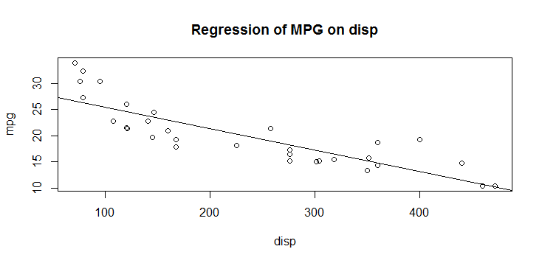
Plotting
In R, graphs are typically created interactively
Step-by-step features can be added to a plot in R
Let’s use the inbuilt “mtcars” dataset to understand ploting on R
The graph produced:
> data(mtcars)
> attach(mtcars) #database is searched by R when evaluating a variable, so objects in the database can be accessed by simply giving their names
> plot(disp,mpg, type=“p”) #will generate (x,y) dot plot
> abline(lm(mpg~disp)) #will generate a regression line on (x,y) dot plot graph
> title("Regression of MPG on disp") #to add label to the graph

Slide 195
Plotting (contd.)
By default, plot() function has type set to “p” which means point plot
The type of plot can be altered
Type | Description
p | points
l | lines
o | overplotted points and lines
b, c | points (empty if "c") joined by lines
s, S | stair steps
h | histogram-like vertical lines
n | does not produce any points or lines

Slide 196
Saving Graphs
Graphs could be exported to any format in R
Below is the list of functions and the output graphs presented in different types
Function | Output to
pdf("mygraph.pdf") | pdf file
win.metafile("mygraph.wmf") | windows metafile
png("mygraph.png") | png file
jpeg("mygraph.jpg") | jpeg file
bmp("mygraph.bmp") | bmp file
postscript("mygraph.ps") | postscript file

Slide 197
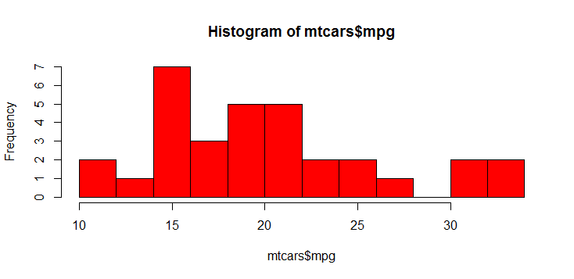
Histograms
Histograms can be created by hist() function
Colored Histogram with different Number of bins
> hist(mtcars$mpg, breaks=12, col="red")

Slide 198
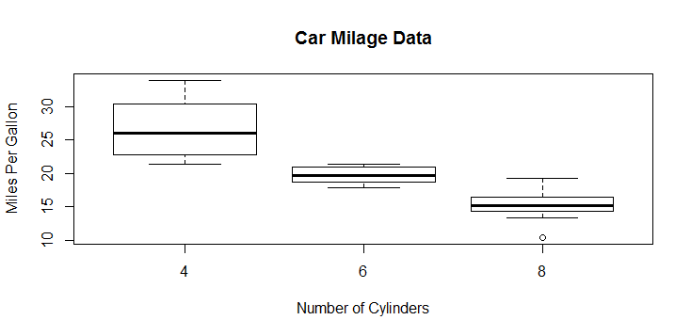
Boxplot
Boxplots can be created for individual variables or for variables by group
# Boxplot of MPG by Car Cylinders > boxplot(mpg~cyl,data=mtcars, main="Car Milage Data", xlab="Number of Cylinders", ylab="Miles Per Gallon")

Slide 199
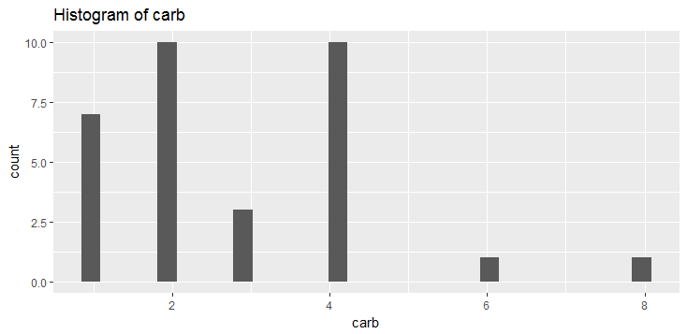
Ggplot2
The ggplot2 package offers a powerful graphics language for creating elegant and complex plots. Ggplot2 allows to create graphs that represent both univariate and multivariate numerical and categorical data in a straightforward manner. Grouping can be represented by color, symbol, size, and transparency. The creation of trellis plots (i.e., conditioning) is relatively simple.
There are two major functions that can be used in ggplot2
qplot() – for quick plots
ggplot() – for fine, granular control
Let’s start with preparing the current R session for ggplot :
X`
> install.packages(“ggplot2”) #to install ggplot2 in R
> library(ggplot2) #to activate ggplot in the current session
> qplot(data=mtcars, x=carb,main="Histogram of carb") #for histogram

Slide 200
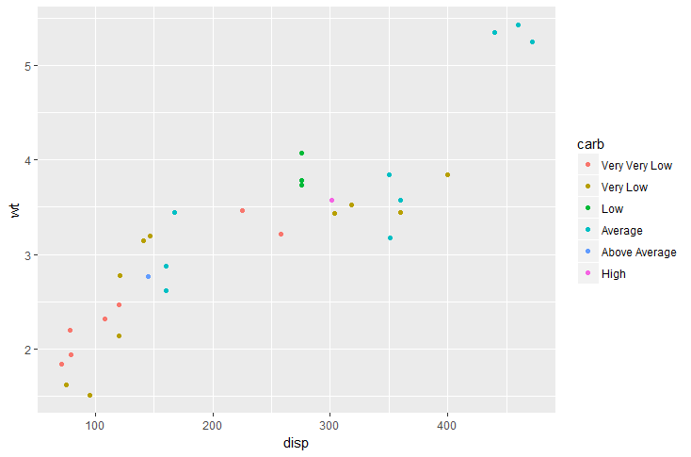
Qplot
We can use qplot to create color coded scatterplots
> unique(mtcars$am) #am is a factor variable with only to unique values
[1] 1 0
> mtcars$carb #A numeric variable
[1] 4 4 1 1 2 1 4 2 2 4 4 3 3 3 4 4 4 1 2 1 1 2 2 4 2 1 2 2 4 6 8 2
> mtcars$carb<-factor(mtcars$carb) #converting to factor for better visualization
> mtcars$carb
[1] 4 4 1 1 2 1 4 2 2 4 4 3 3 3 4 4 4 1 2 1 1 2 2 4 2 1 2 2 4 6 8 2
Levels: 1 2 3 4 6 8
> qplot(data=mtcars, x=disp, y=wt, color=carb)

Slide 201
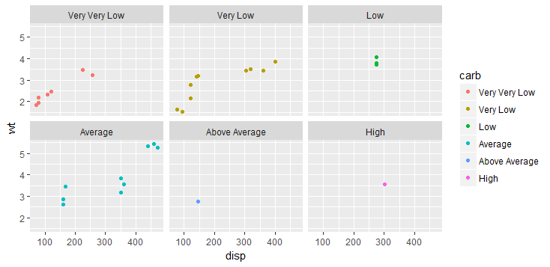
Facets in Qplot
For better visualization of the factor variable in a two variable scatter plot, sometimes plotting the levels in different facets is quite useful
> qplot(data=mtcars, x=disp, y=wt, color=carb, facets=~carb)

Slide 202
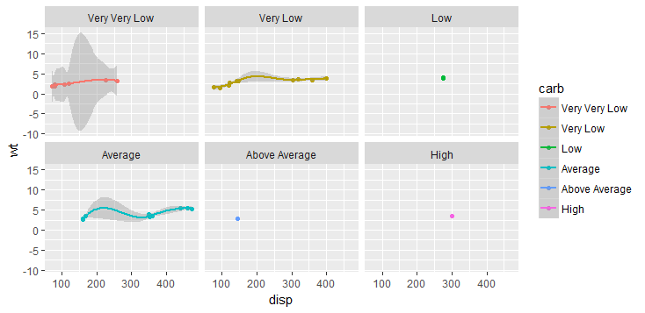
Trend lines- Statistical Transformation
In ggplot2, a plot can be thought of made up at different layers. A trend line is a statistical transformation layer that is overlaid on the graph. A trend line can be added to any plot. A plot can be saved as variable and features could be added at every step
> myplot <- qplot(data=mtcars, x=disp, y=wt, color=carb, facets = ~carb)
> myplot <- myplot + stat_smooth(method="loess")
> myplot

Slide 203
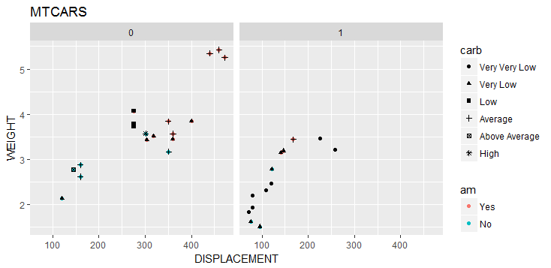
GGPLOT
Ggplot allows for extreme customization in the graphics that we create.
> myggplot <- ggplot(mtcars, aes(disp,wt)) #to set up the datasets in ggplot function
> myggplot <- myggplot + geom_point() #geom_point produces scatter plot
> mycolor <- myggplot + geom_point(color="red") #scatter plot in red
> myaes <- myggplot + geom_point(aes(colour=am)) > #aes produces color for eac levels of the factor, same as shown in qplot
> myaes <- myaes + geom_point(aes(shape=carb)) + facet_wrap(~vs,nrow=1) + ggtitle(“MTCARS”) + labs(x="DISPLACEMENT",y="WEIGHT") > #depicts the three factors on the same graph

Slide 204
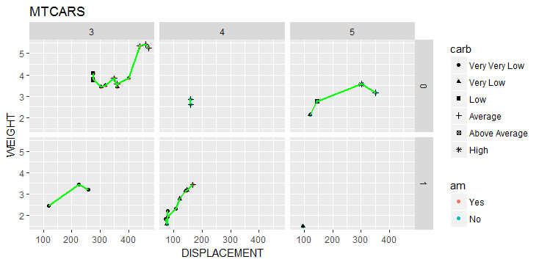
Adding more features
Further integration on factors is possible. Facet_grid can be used for doing so
> myaes2 <- myaes + geom_point(aes(shape=carb)) + ggtitle(“MTCARS”) + labs(x="DISPLACEMENT",y="WEIGHT") #used from last page
> Myface <- myaes2 + facet_grid(vs~gear) #breaks the gaphs on vs-gear levels
> Myline <- myface + geom_line(color=“green”, lwd=1) #Adding a line plot

Slide 205
Training Schedule
Day | Chapters
1-2 | Introduction to R, Vectors, Lists, Arrays
3 | Matrices, Data Frames, Factors, Import/Export
4 | Control flow, Loops
5 | Vectorization, Apply Family
6 | Functions, Utilities
7 | Data Prep, Data Cleaning
8 | Dplyr, visualization
Take away | Case Study and discussions

Slide 206

Case Study - Flights
This project involves data on flight departure and arrival times from the Bureau of Transportation Statistics. Source: Ontime Table for flights in January, 2013.
Ontime flight data.zip
Files available:
ONTIME1.csv – contains the flight data aircarriernames.csv - a table with the names of airlines and a 2-3 letter code
airport_codes.csv - a lookup table for the DOT integer codes
Before turning over for questions, please do the following:
Keep all datasets in one location
Set the working directory to the above location
Load the CSV files as a dataframe using read.csv and read.table functionalities

Slide 207
Case Study Questions
Are there any flights with missing CARRIER information?
Are there any flights with carrier codes that aren't found in the carrier look-up table?
How many airlines had a flight in January 2013 in this database?
Merge the ontime flight data with the airport codes to create a text field description of the originating airport to the ontime flight data frame. When done, use the str command to exhibit the characteristics of the new data.frame. Note that this didn't introduce any new records.
Use the lookup table of carrier codes to find the code for United Airlines. Create a subset containing only United Airlines flights
Create a delay indicator variable (boolean) specifying whether or not a flight was delayed
What percentage of United Airlines flights had a delay?
Sort the data frame generated in 8 by the amount of delay in decreasing order
Which originating airports had the 3 longest delays for United Airlines in January 2013?
Use loops and apply family functions to answer the following:
Which airlines had the best on-time performance record?
What are the prevalent reasons for delays?
Which airports had the greatest number of weather delays?
Which airport saw weather delays on the greatest number of days?

Slide 208
Bibliography
The Art of R Programming , Normann Matloff
www.rdocumentation.org
https://cran.r-project.org/
www.analyticsvidha.com
http://www.kdnuggets.com/
www.rbloggers.com
http://statistics.ats.ucla.edu/stat/r/
http://vita.had.co.nz/papers/tidy-data.pdf
https://cran.r-project.org/doc/contrib/de_Jonge+van_der_Loo-Introduction_to_data_cleaning_with_R.pdf
http://dept.stat.lsa.umich.edu/~kshedden/Courses/Stat401/Notes/401-bivariate-slides.pdf
https://cran.r-project.org/web/packages/dplyr/vignettes/two-table.html
http://transtats.bts.gov/DL_SelectFields.asp?Table_ID=236

